Slide 1

CSCI E-25 Computer Vision
Feature Extraction
Steve Elston
Copyright 2021, 2022, 2023, 2024, 2025, Stephen F Elston. All rights reserved.

Slide 2
Feature Extraction
Computer vision algorithms require features
Feature extraction is foundational for most CV tasks
Classical CV relies on extraction of hand-engineered features
Long history starting in 1970s
Often computationally efficient for high-volume and real-time
Still used in CV pipelines
Deep neural networks learn a feature set
Have superseded classical methods in many cases
But often computationally intensive
Much more on this later!

Slide 3
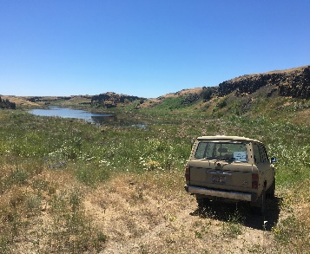
CV Pipeline Architecture
CV pipeline requires generating feature map
Preprocessing image enhancement
Feature Extraction
Task-specific processing
Inference
Input Image
Multi-dimensional feature map
Our focus today

Slide 4
Feature Extraction
Computer vision algorithms require features
Feature extraction is a foundation many CV algorithms
Our goal is to create a feature map for the task we wish to perform
Given the prevalence of neural nets in generating feature maps why study classical methods?
We can analytically understand classical methods, giving insight into what works and why
If classical methods fail, the NN algorithm will likely fail for the same reasons
In many cases, preprocessing with classical methods can improve DL algorithm performance

Slide 5
Feature Extraction
Many applications and types of feature extraction algorithms
Commonly used features
Edges
Corners and other interest points
Textures
A few widely applied applications
Locating and identifying objects in images
Stitching images together
Models of motion from a series of images – optical flow
Stereo vison and constructing 3-dimensional scenes
Efficient image and video search

Slide 6

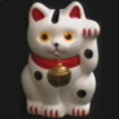
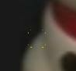
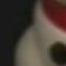
Feature Extraction
Example: How is the image transformed between the images?
Locate interest points or key points
For patches around the interest points extract statistics - descriptors
Matching points are identified by descriptors
Images can be warped to match – a machine learning problem
A₁
B₃
A₂
A₃
B₁
B₂

Slide 7
Feature Extraction
Key points for this lesson
Use of gradients to detect edges
Decomposition of gradients as general interest point detectors
Hough transform for enhancing edges
How Harris corner detector works
Using statistics of gradients to construct descriptors - HOG
How to identify interest points with the SIFT algorithm
The basics of the BRIEF algorithm for interest point matching
Interest point detection across scales

Slide 8
Finding Edges and Gradients

Slide 9
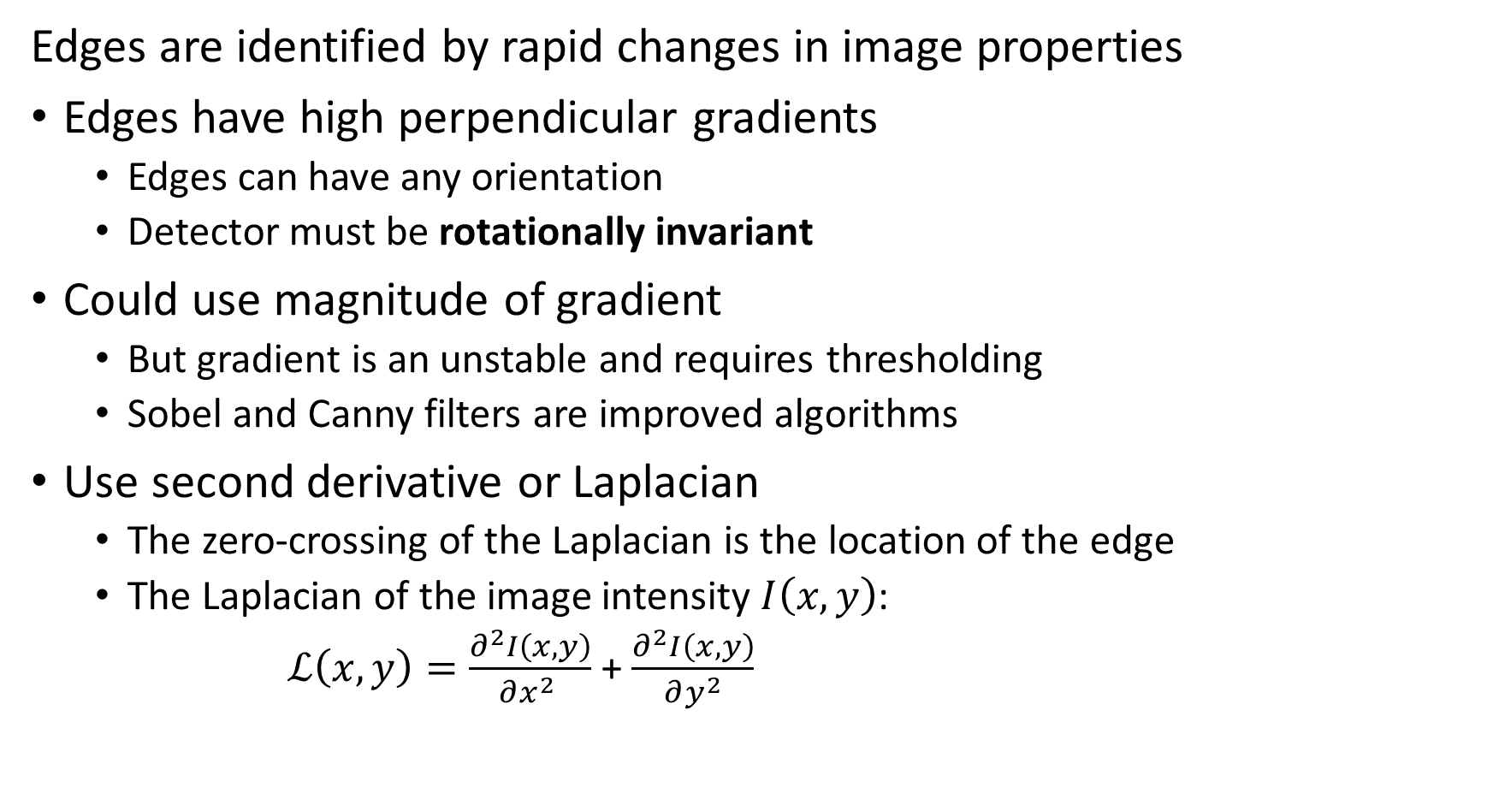
Finding Edges
Edges are identified by rapid changes in image properties
Edges have high perpendicular gradients
Edges can have any orientation
Detector must be rotationally invariant
Could use magnitude of gradient
But gradient is an unstable and requires thresholding
Sobel and Canny filters are improved algorithms
Use second derivative or Laplacian
The zero-crossing of the Laplacian is the location of the edge
The Laplacian of the image intensity $I\left(x,y\right)$:
$ℒ\left(x,y\right)=\frac{∂^{2}I\left(x,y\right)}{∂x^{2} }$ + $\frac{∂^{2}I\left(x,y\right)}{∂y^{2}}$

Slide 10
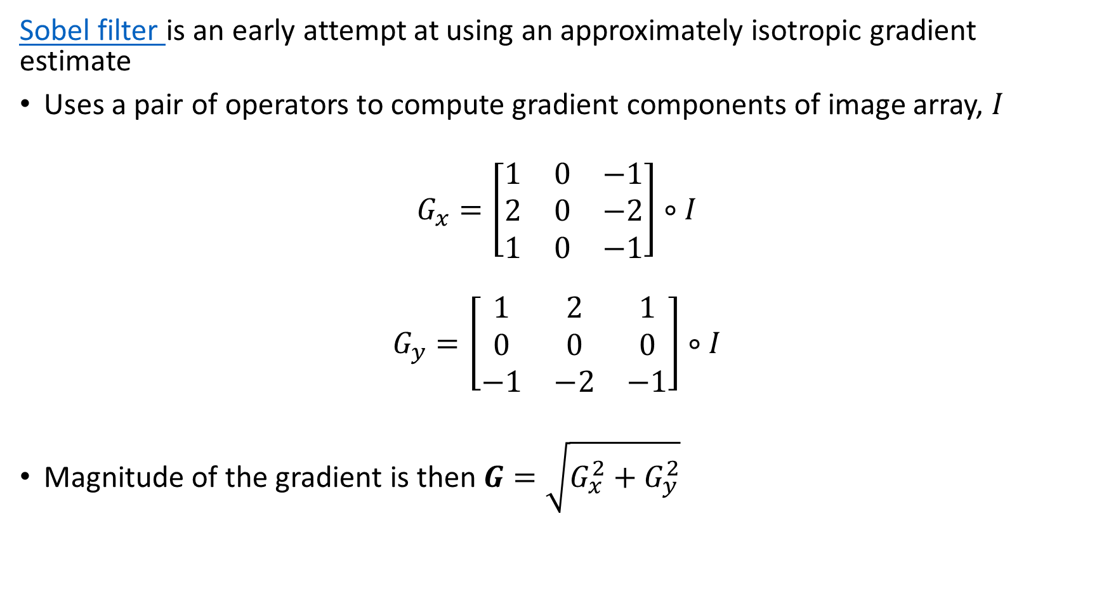
Finding Edges with Sobel Filter
Sobel filter is an early attempt at using an approximately isotropic gradient estimate
Uses a pair of operators to compute gradient components of image array, $I$
$$G_{x}=\left[\begin{matrix}1 & 0 & −1 \\ 2 & 0 & −2 \\ 1 & 0 & −1\end{matrix}\right]∘I$$
$$G_{y}=\left[\begin{matrix}1 & 2 & 1 \\ 0 & 0 & 0 \\ −1 & −2 & −1\end{matrix}\right]∘I$$
Magnitude of the gradient is then $G=\sqrt{G_{x}^{2}+G_{y}^{2}}$

Slide 11
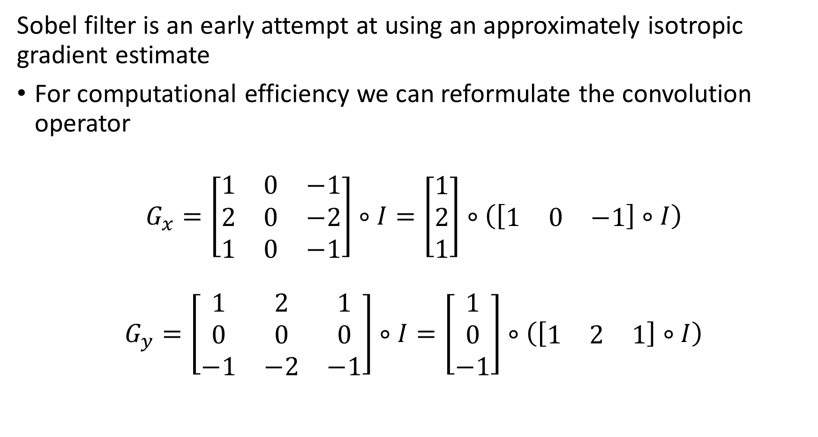
Finding Edges with Sobel Filter
Sobel filter is an early attempt at using an approximately isotropic gradient estimate
For computational efficiency we can reformulate the convolution operator
$$G_{x}=\left[\begin{matrix}1 & 0 & −1 \\ 2 & 0 & −2 \\ 1 & 0 & −1\end{matrix}\right]∘I=\left[\begin{matrix}1 \\ 2 \\ 1\end{matrix}\right]∘\left(\left[\begin{matrix}1 & 0 & −1\end{matrix}\right]∘I\right)$$
$$G_{y}=\left[\begin{matrix}1 & 2 & 1 \\ 0 & 0 & 0 \\ −1 & −2 & −1\end{matrix}\right]∘I=\left[\begin{matrix}1 \\ 0 \\ −1\end{matrix}\right]∘\left(\left[\begin{matrix}1 & 2 & 1\end{matrix}\right]∘I\right)$$

Slide 12
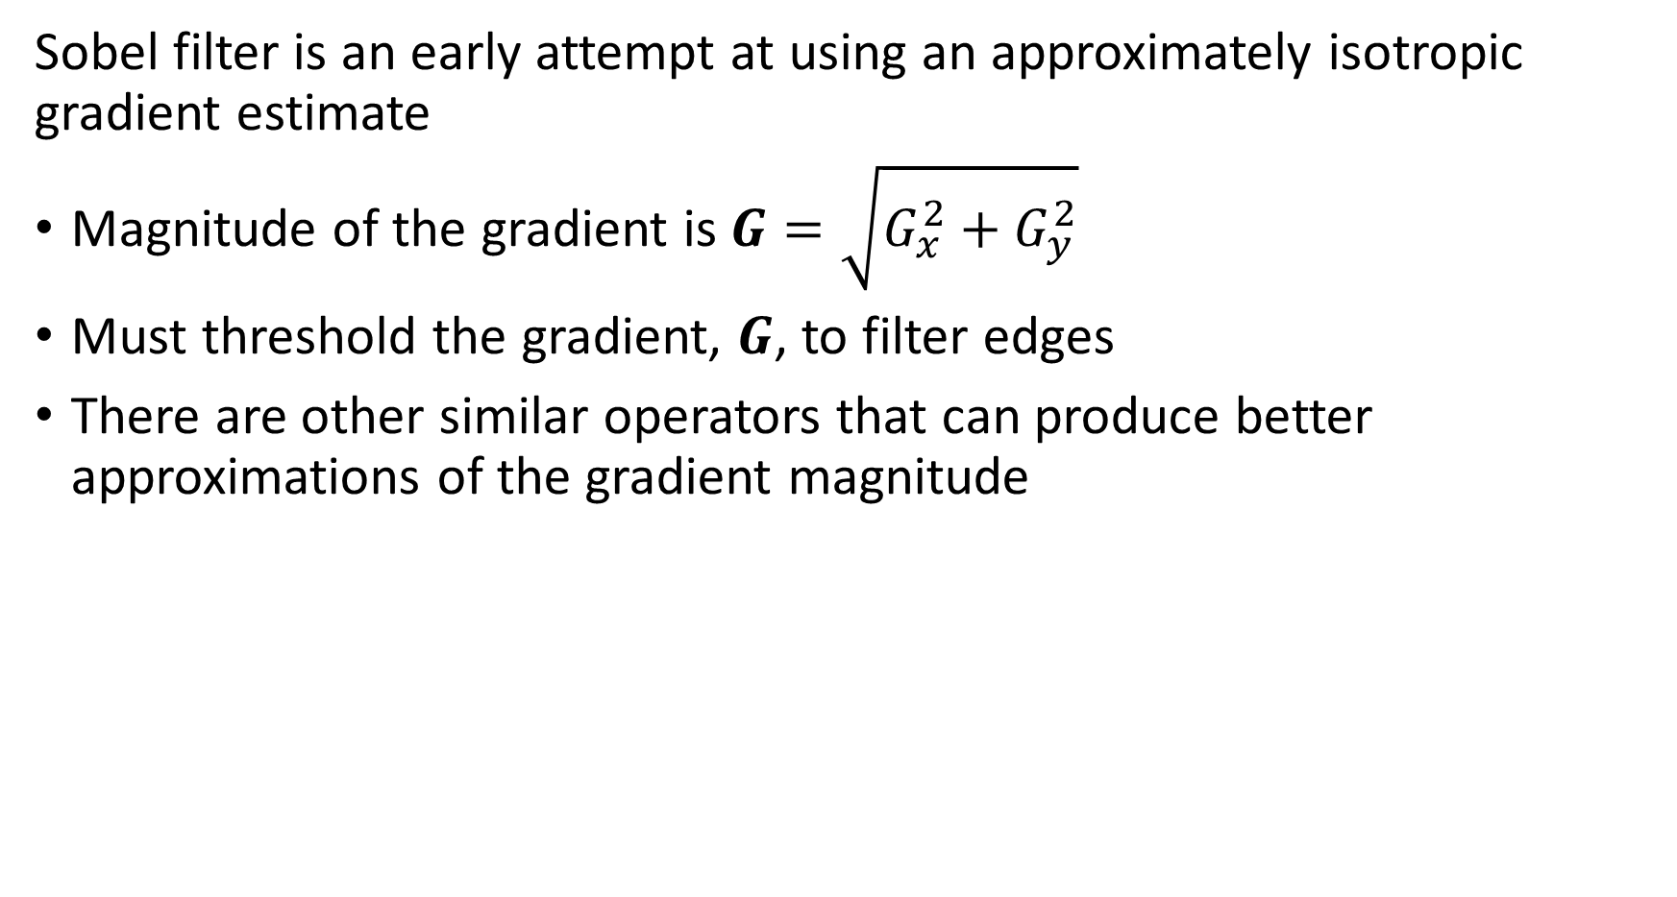
Finding Edges with Sobel Filter
Sobel filter is an early attempt at using an approximately isotropic gradient estimate
Magnitude of the gradient is $G=\sqrt{G_{x}^{2}+G_{y}^{2}}$
Must threshold the gradient, $G$, to filter edges
There are other similar operators that can produce better approximations of the gradient magnitude

Slide 13
Finding Edges with Gradients with the Canny Filter

Slide 14
Finding Edges with Canny Filter
Canny filter is a sophisticated multi-stage algorithm for finding edges in images
Detects edges with a low error rate
Accurately locates the edge
Each edge in the image should only be marked once

Slide 15
Finding Edges with Canny Filter
Canny filter is a sophisticated multi-stage algorithm for finding edges in images
We will not explore the details here
Basic steps of the algorithm:
Apply a Gaussian filter to smooth edges and remove noise
Compute the intensity (magnitude) of the gradients, e.g. with Sobel filter
The gradients are filtered using a double threshold with upper and lower bounds on the gradient to identify potential edge pixels
Filter pixels of appropriate magnitude (by threshold) with a hysteresis algorithm to find adjoining pixels likely to be part of edges

Slide 16
Finding Edges With Laplacian

Slide 17
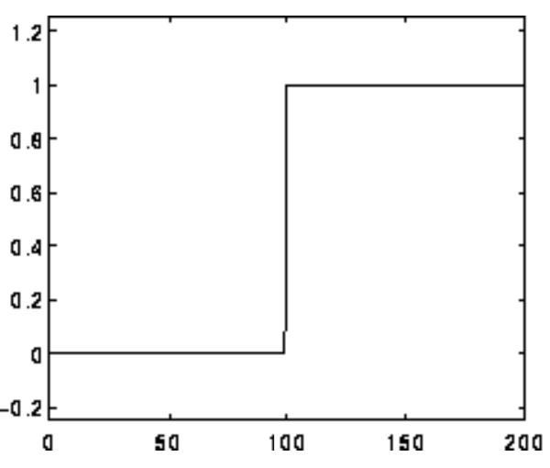
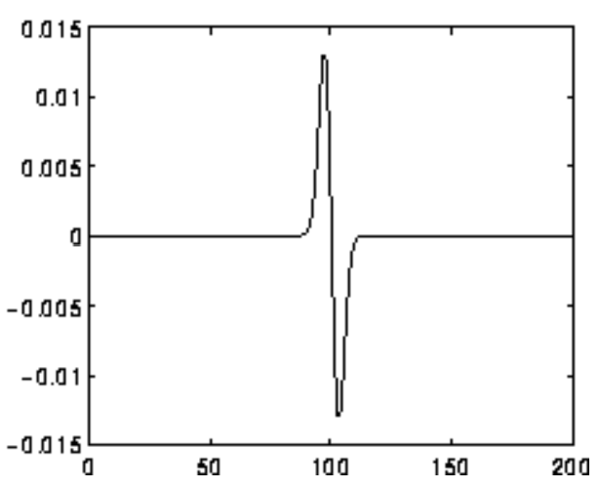
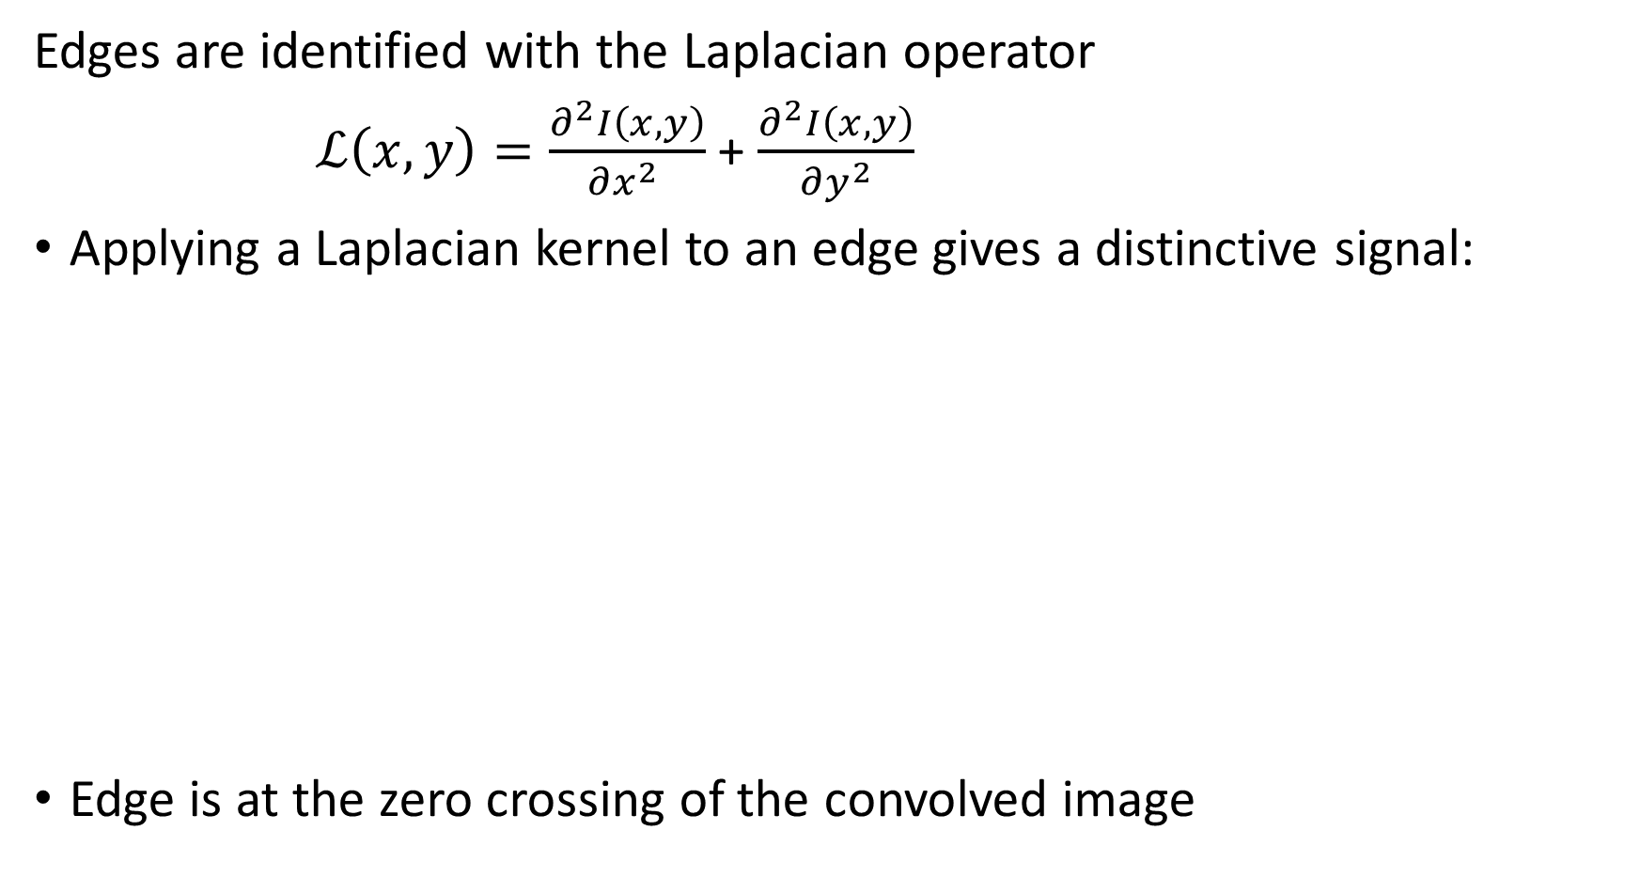
Finding Edges
Edges are identified with the Laplacian operator
$ℒ\left(x,y\right)=\frac{∂^{2}I\left(x,y\right)}{∂x^{2} }$ + $\frac{∂^{2}I\left(x,y\right)}{∂y^{2}}$
Applying a Laplacian kernel to an edge gives a distinctive signal:
Edge is at the zero crossing of the convolved image
Convolution with Laplacian
Credit, R. Fisher, S. Perkins, A. Walker and E. Wolfart

Slide 18
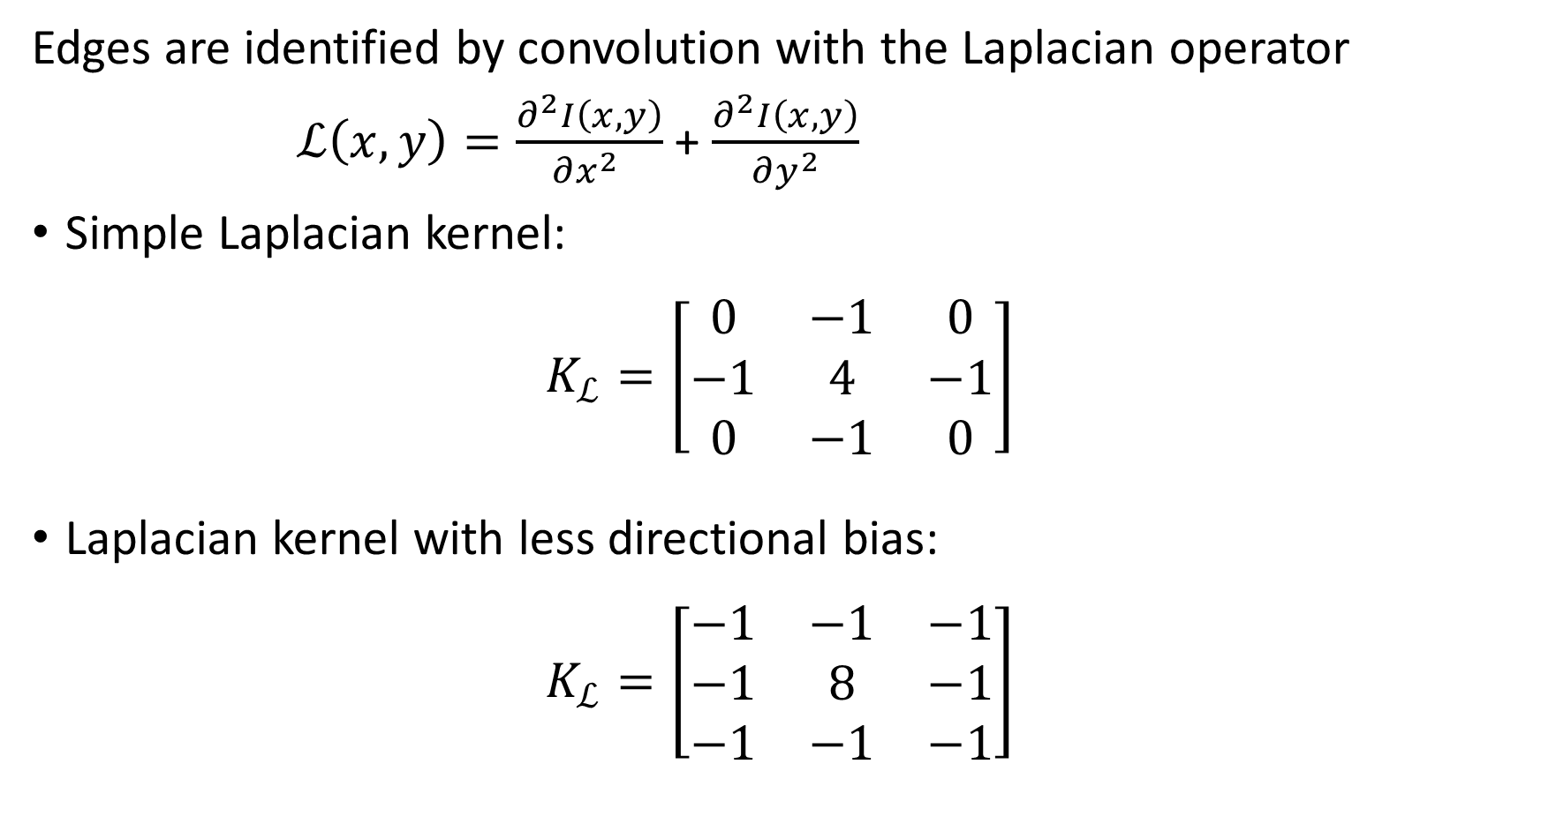
Finding Edges
Edges are identified by convolution with the Laplacian operator
$ℒ\left(x,y\right)=\frac{∂^{2}I\left(x,y\right)}{∂x^{2} }$ + $\frac{∂^{2}I\left(x,y\right)}{∂y^{2}}$
Simple Laplacian kernel:
$$K_{ℒ}=\left[\begin{matrix}0 & −1 & 0 \\ −1 & 4 & −1 \\ 0 & −1 & 0\end{matrix}\right]$$
Laplacian kernel with less directional bias:
$$K_{ℒ}=\left[\begin{matrix}−1 & −1 & −1 \\ −1 & 8 & −1 \\ −1 & −1 & −1\end{matrix}\right]$$

Slide 19
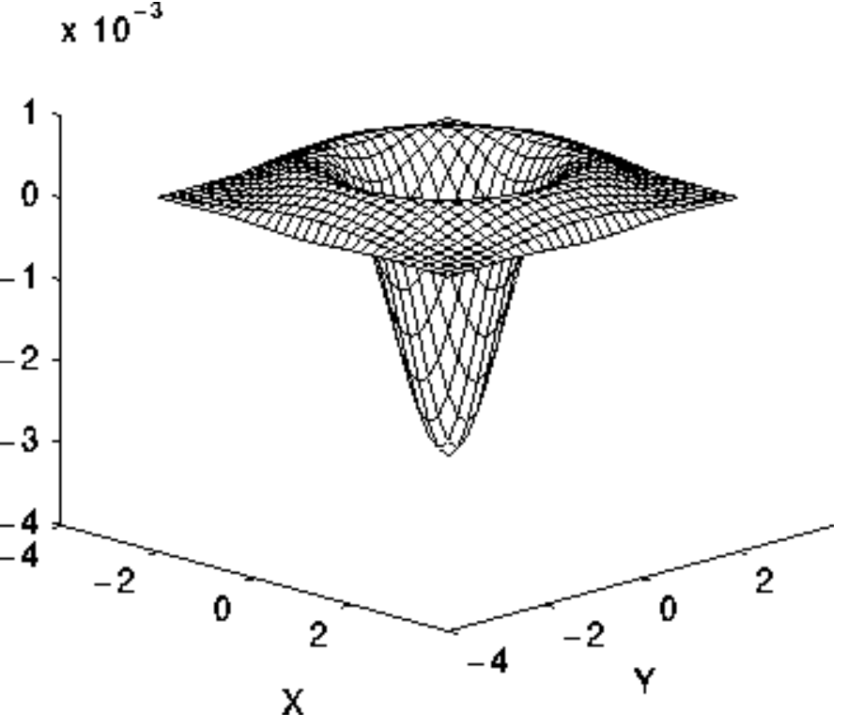
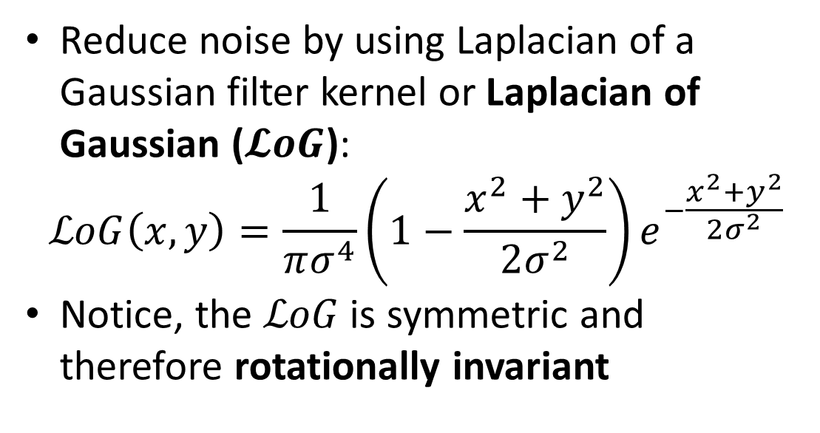
Finding Edges
Laplacian of a Gaussian reduces noise
The Laplacian operator is effective at finding edges, but susceptible to noise
Reduce noise by using Laplacian of a Gaussian filter kernel or Laplacian of Gaussian ($𝓛oG$):
$$ℒoG\left(x,y\right)=\frac{1}{πσ^{4}}\left(1−\frac{x^{2}+y^{2}}{2σ^{2}}\right)e^{−\frac{x^{2}+y^{2}}{2σ^{2}}}$$
Notice, the $ℒoG$is symmetric and therefore rotationally invariant
Credit, R. Fisher, S. Perkins, A. Walker and E. Wolfart

Slide 20
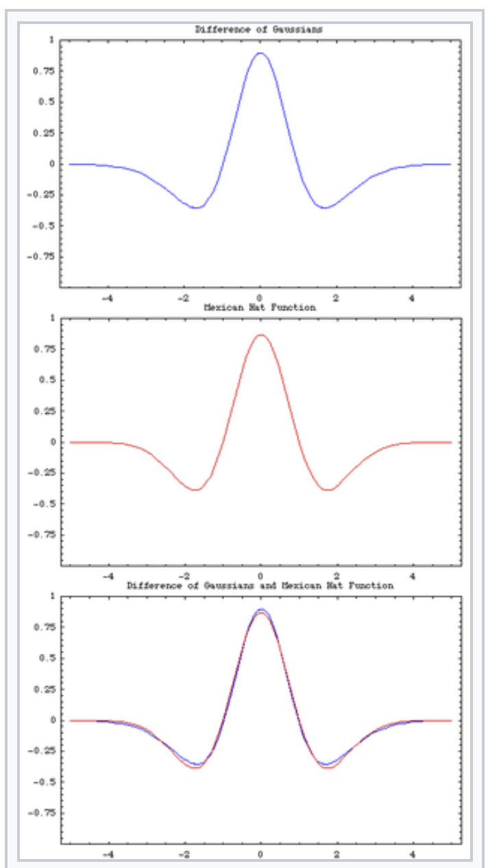
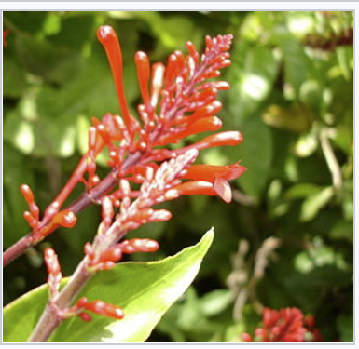
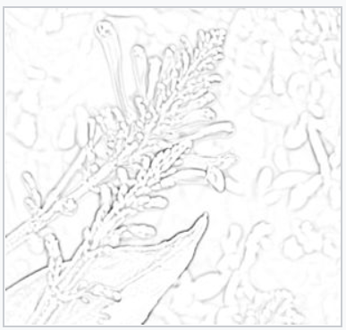
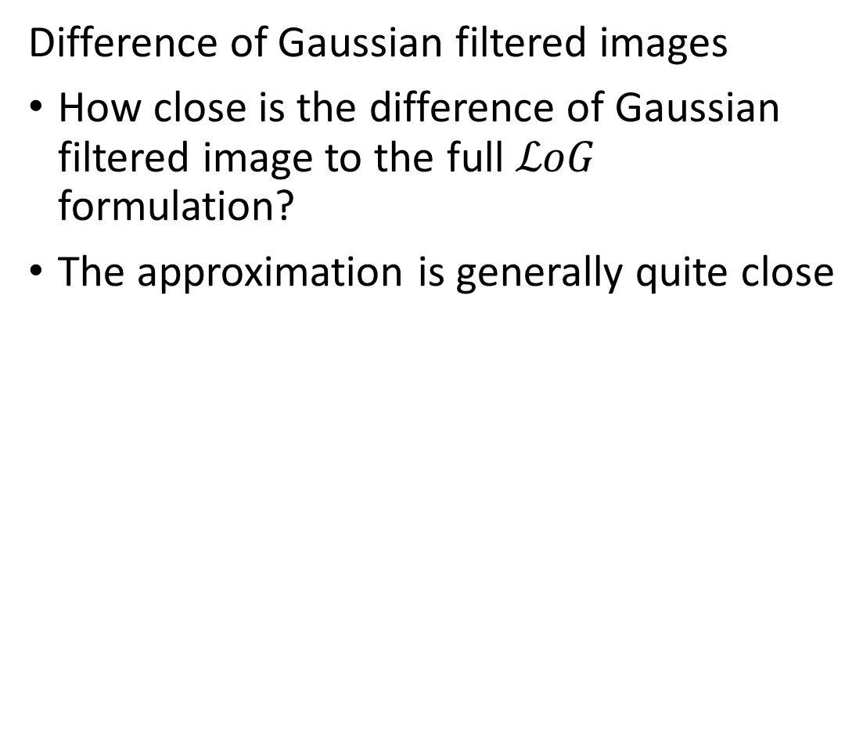
Finding Edges
Difference of Gaussian filtered images
How close is the difference of Gaussian filtered image to the full $ℒoG$ formulation?
The approximation is generally quite close
Gray-scale then difference of Gaussians
Credit, Wikipedia commons

Slide 21
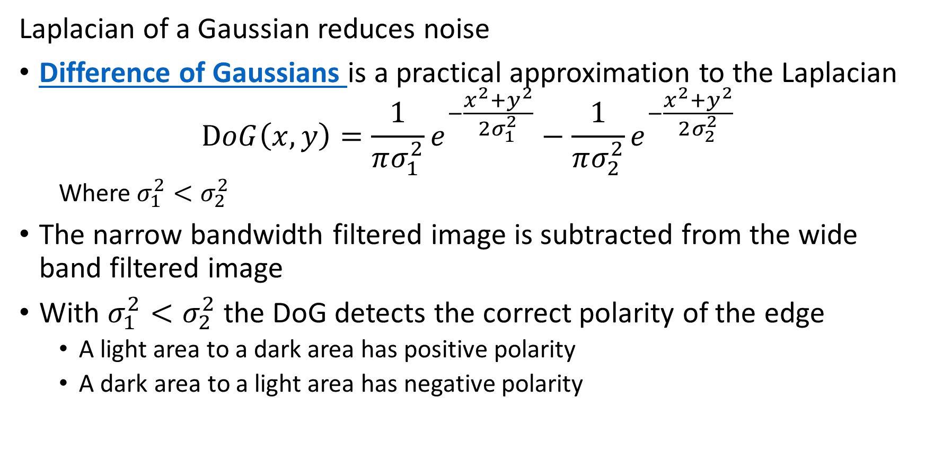
Finding Edges
Laplacian of a Gaussian reduces noise
Difference of Gaussians is a practical approximation to the Laplacian
$$DoG\left(x,y\right)=\frac{1}{πσ_{1}^{2}}e^{−\frac{x^{2}+y^{2}}{2σ_{1}^{2}}}−\frac{1}{πσ_{2}^{2}}e^{−\frac{x^{2}+y^{2}}{2σ_{2}^{2}}}$$
Where$σ_{1}^{2}<σ_{2}^{2}$
The narrow bandwidth filtered image is subtracted from the wide band filtered image
With $σ_{1}^{2}<σ_{2}^{2}$ the DoG detects the correct polarity of the edge
A light area to a dark area has positive polarity
A dark area to a light area has negative polarity

Slide 22
Edges and the Hough Transform

Slide 23
Why Enhance Edges?
Edge detection algorithms only operate locally
Only pieces of edges may be detected
Parts of an edge may be occulated by other objects in the image
Gradients along edges may vary considerably
We can use a Hough transform to enhance edges in an image
Many versions of Hough transform have been developed
In order of computational complexity and practicality
Straight line: our focus here
Circles and ellipses
Arbitrary curves and shapes
3D surfaces

Slide 24
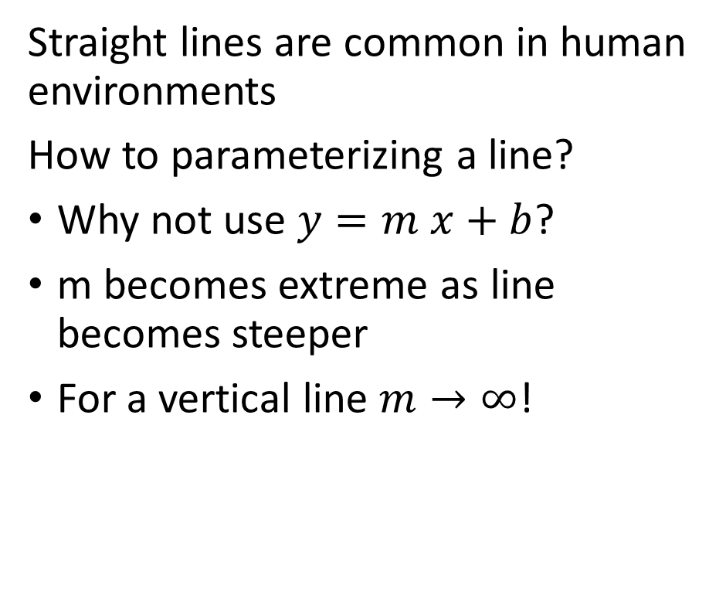
Straight Line Hough Transform
Straight line Hough transform uses a simple voting algorithm to find lines in images
Straight lines are common in human environments
How to parameterizing a line?
Why not use $y=m x+b$?
m becomes extreme as line becomes steeper
For a vertical line $m→∞$!
y
x

Slide 25

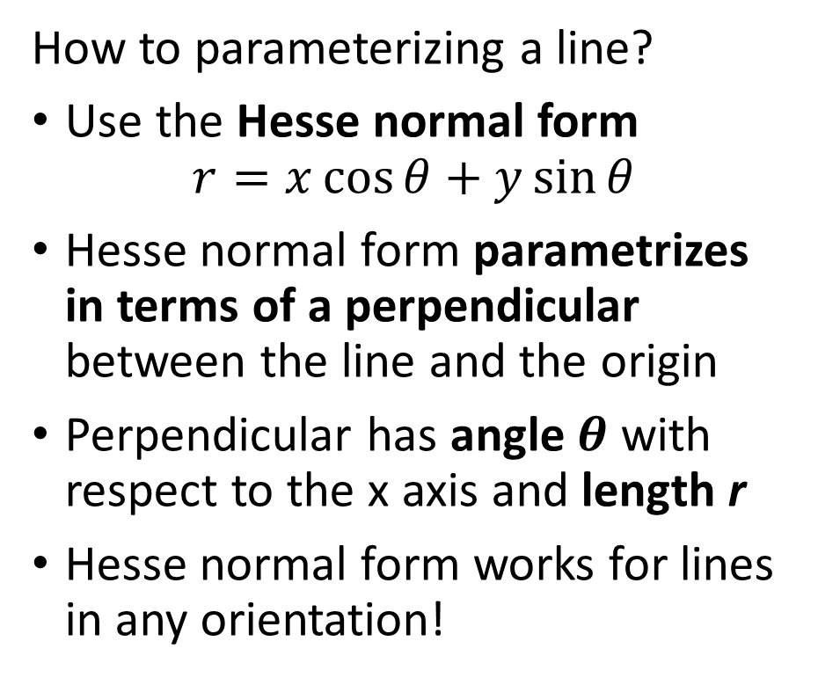
Straight Line Hough Transform
Straight line Hough transform uses a simple voting algorithm to find lines in images
How to parameterizing a line?
Use the Hesse normal form
$$r=x\cos{θ}+y\sin{θ}$$
Hesse normal form parametrizes in terms of a perpendicular between the line and the origin
Perpendicular has angle $θ$ with respect to the x axis and length r
Hesse normal form works for lines in any orientation!
y
r
$$θ$$
x

Slide 26
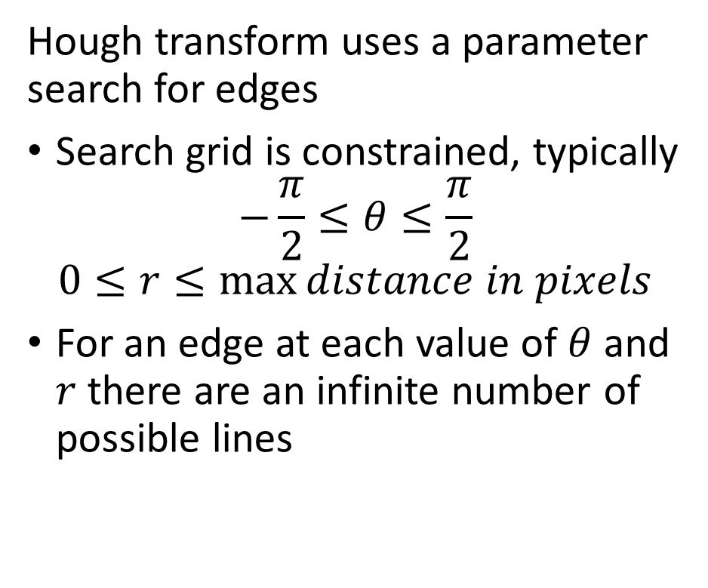
Straight Line Hough Transform
Straight line Hough transform uses a simple voting algorithm to find lines in images
Hough transform uses a parameter search for edges
Search grid is constrained, typically
$$−\frac{π}{2}≤θ≤\frac{π}{2}$$
$$0≤r≤\max{distance in pixels}$$
For an edge at each value of $θ$ and $r$ there are an infinite number of possible lines
y
x

Slide 27
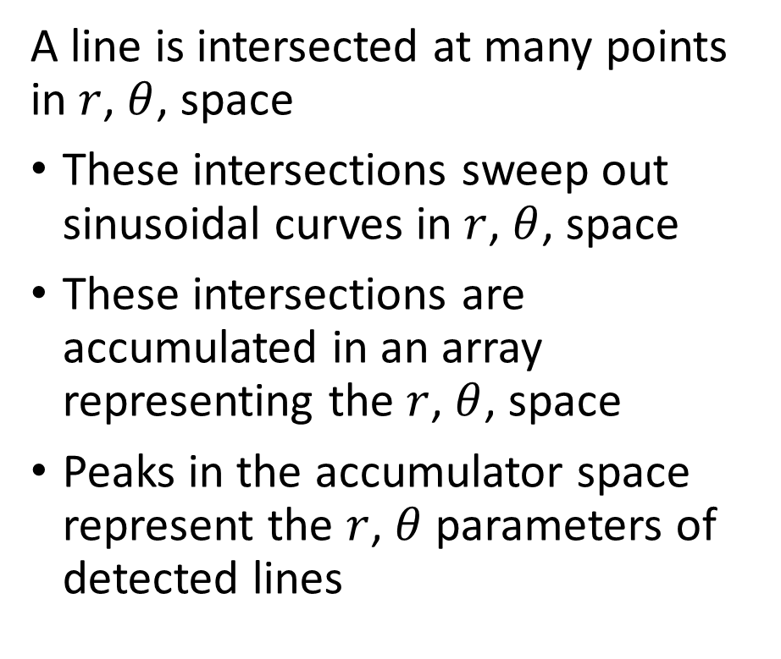
Straight Line Hough Transform
Straight line Hough transform uses a simple voting algorithm to find lines in images
A line is intersected at many points in $r$, $θ$, space
These intersections sweep out sinusoidal curves in $r$, $θ$, space
These intersections are accumulated in an array representing the $r$, $θ$, space
Peaks in the accumulator space represent the $r$, $θ$ parameters of detected lines
y
x

Slide 28
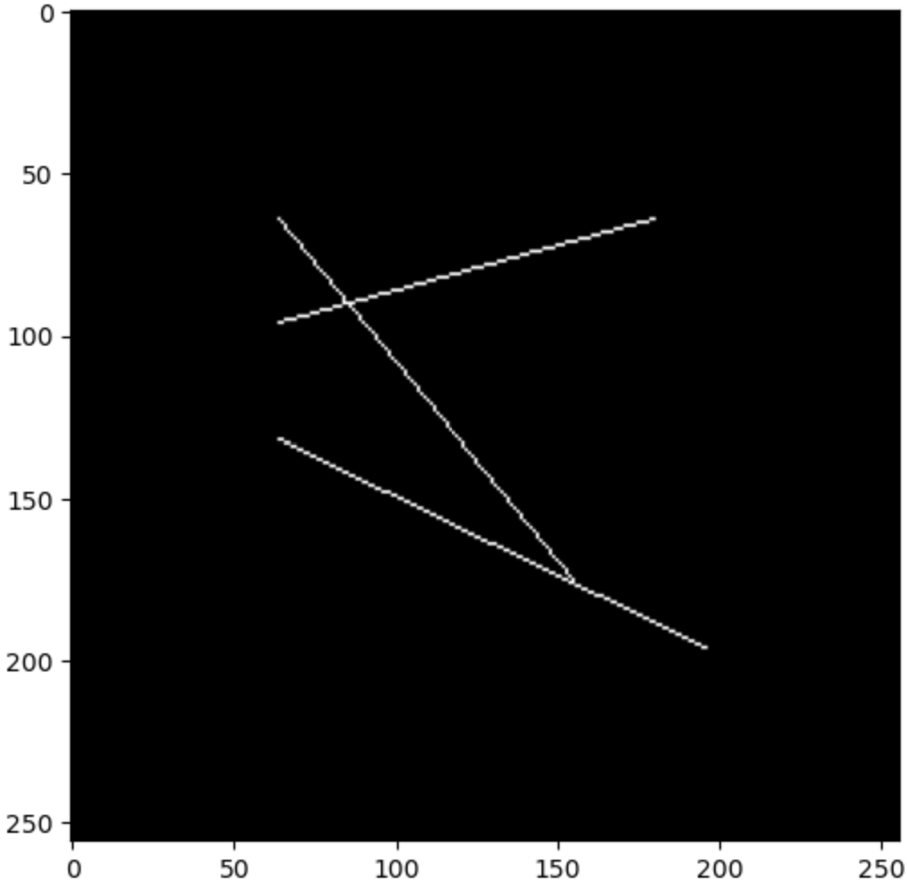
Straight Line Hough Transform
Hough transform example
Start with a synthetic image
Contains 3 lines

Slide 29
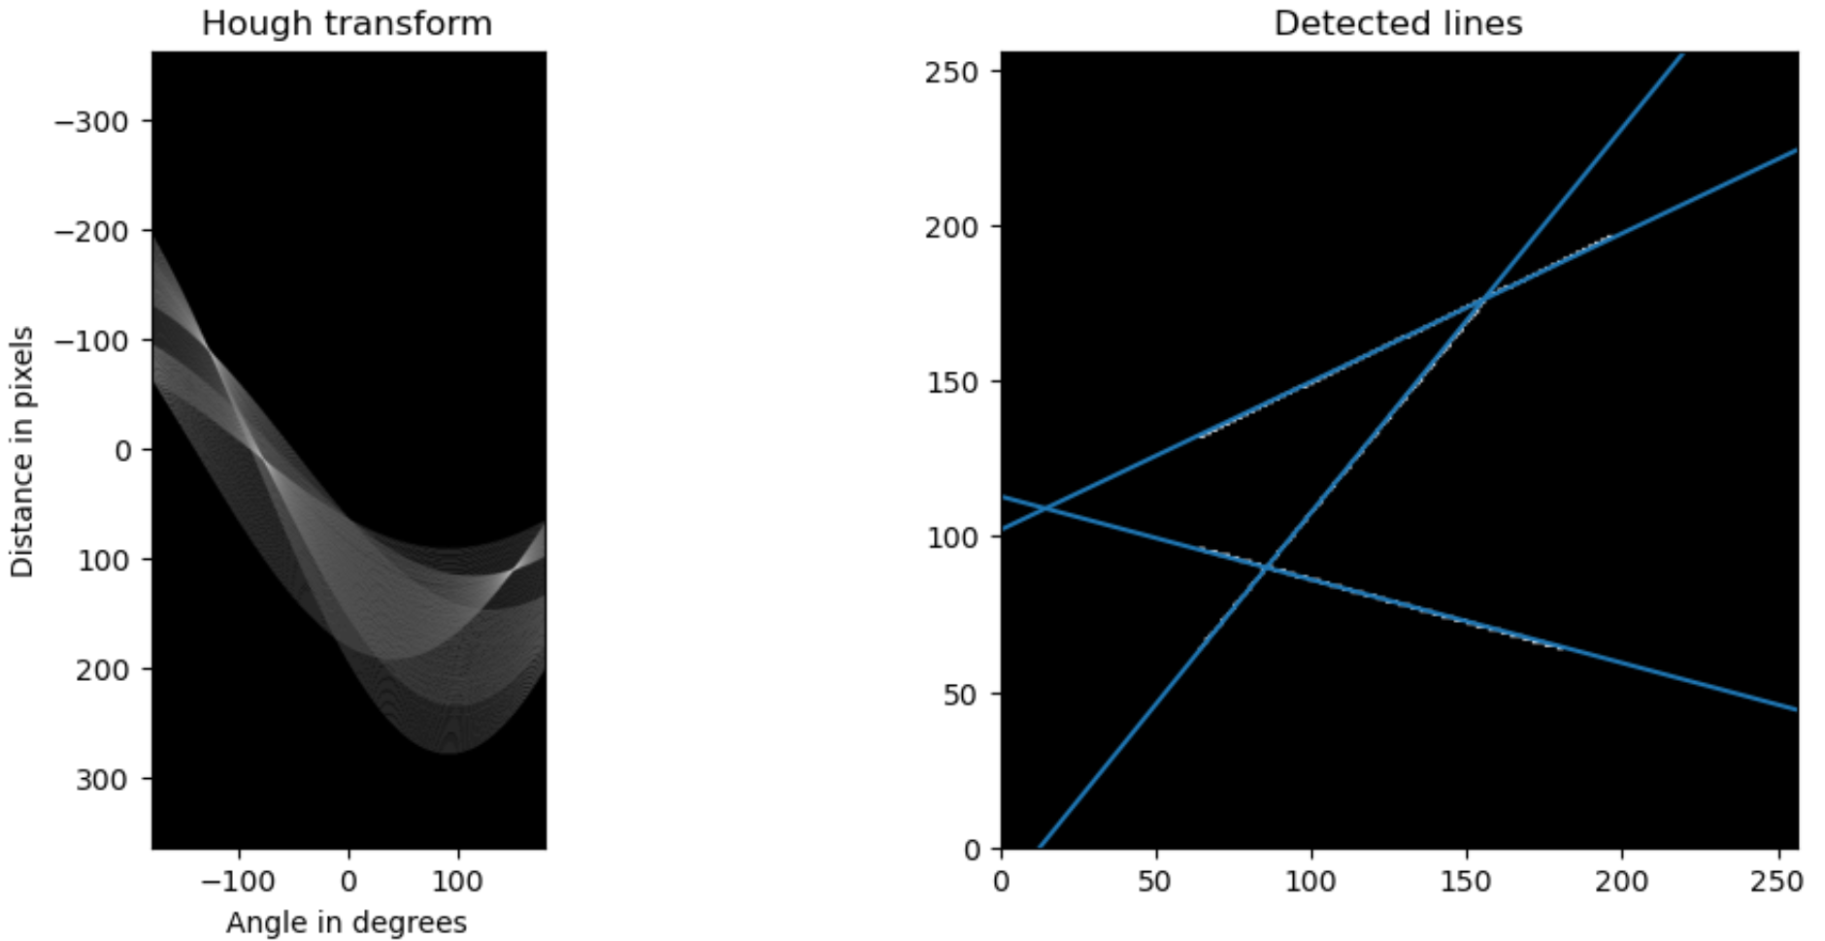
Straight Line Hough Transform
Hough transform example
Hough transform accumulator has three peaks, corresponding to 3 detected lines

Slide 30
Interest Point Detection

Slide 31
Interest Point Detection
Interest points are important features for many CV algorithms
Edges are problematic
Too dense – creates alignment ambiguity between views
No unique characteristic – lines are similar
Poor localization – features are elongated
Interest points are better
Tend to be sparse
Often have unique identifiable characteristics
Points – high location specificity
Other terms for interest points
Key points
Feature points

Slide 32
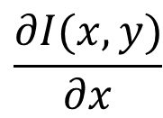
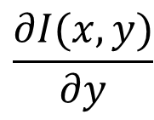
Interest Point Detection
Interest point detection
Why can’t we just use gradients?
Consider the example of a diagonal edge
Diagonal edge has strong perpendicular gradient
Gradient in x and y is same along line segment – poor localization
$$\frac{∂I(x,y)}{∂y}$$
$$\frac{∂I(x,y)}{∂x}$$

Slide 33
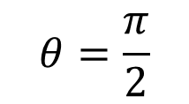
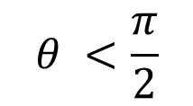
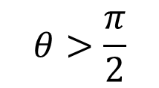
Interest Point Detection
Corners detection is more complex than edge detection
Edges, and curves, have a well defined perpendicular
Locally only one degree of freedom, orientation
Corners have two degrees of freedom
Orientation
Angle between the edges forming the corner
Examples
$$θ=\frac{π}{2}$$
$$θ>\frac{π}{2}$$
$$θ <\frac{π}{2}$$

Slide 34
Interest Point Detection
Corners are a special case of the more general concept of interest points
Interest points occur whereever lines intersect
Examples:
Crossing intersection
Oblique crossing intersection
T intersection
Complex intersection

Slide 35
Interest Point Detection
Similar intensity: Small gradient in all directions
Interest points have more complex gradients than edges
Use convolutional kernel to estimate gradients
Areas of similar intensity
No localization, leads to problems!
Edges have simple perpendicular gradients
Poor localization
Other interest points have rapidly changing gradients in several directions
Edge: Large perpendicular gradients
Interest point: Large gradient in all directions

Slide 36
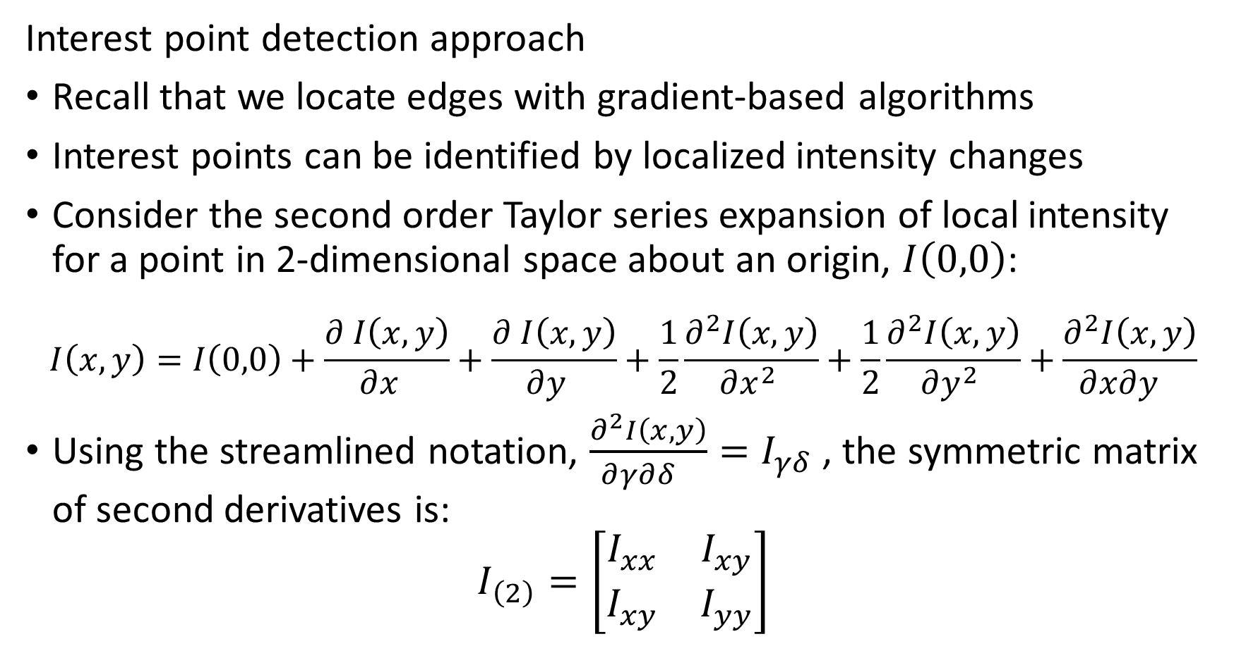
Interest Point Detection
Interest point detection approach
Recall that we locate edges with gradient-based algorithms
Interest points can be identified by localized intensity changes
Consider the second order Taylor series expansion of local intensity for a point in 2-dimensional space about an origin, $I\left(0,0\right)$:
$$I\left(x,y\right)=I\left(0,0\right)+\frac{∂^{ }I\left(x,y\right)}{∂x^{ } }+\frac{∂^{ }I\left(x,y\right)}{∂y^{ } }+\frac{1}{2}\frac{∂^{2}I\left(x,y\right)}{∂x^{2} }+\frac{1}{2}\frac{∂^{2}I\left(x,y\right)}{∂y^{2} }+\frac{∂^{2}I\left(x,y\right)}{∂{x∂y^{ }}^{ } }$$
Using the streamlined notation, $\frac{∂^{2}I\left(x,y\right)}{∂{γ∂δ^{ }}^{ } }=I_{γδ}$ , the symmetric matrix of second derivatives is:
$$I_{\left(2\right)}=\left[\begin{matrix}I_{xx} & I_{xy} \\ I_{xy} & I_{yy}\end{matrix}\right]$$

Slide 37
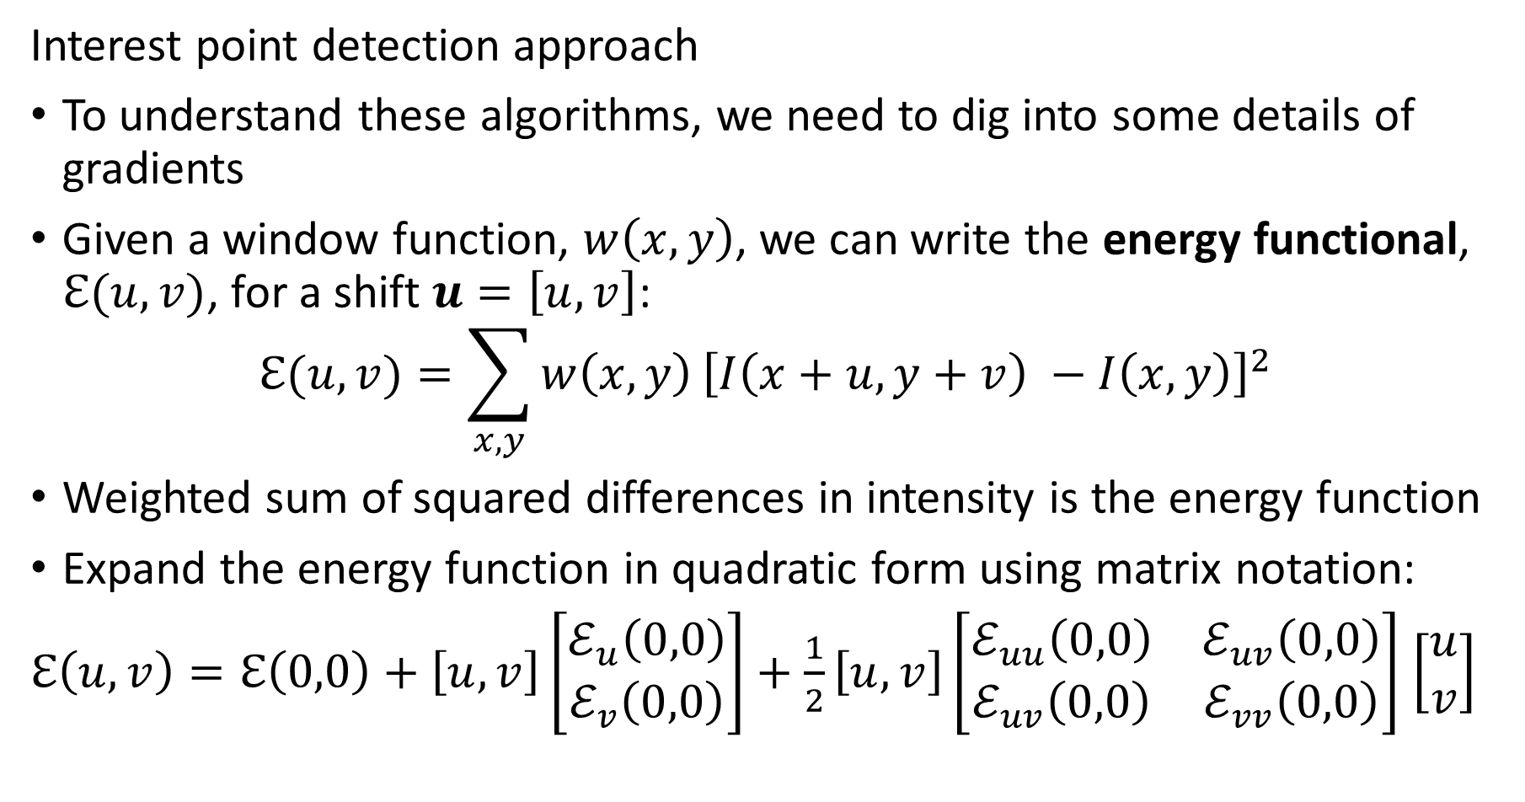
Interest Point Detection
Interest point detection approach
To understand these algorithms, we need to dig into some details of gradients
Given a window function, $w\left(x,y\right)$, we can write the energy functional, $ℇ(u,v)$, for a shift $u=\left[u,v\right]$:
$$ℇ(u,v)=\sum_{x,y}{w\left(x,y\right)}{\left[I\left(x+u, y+v\right) −I\left(x,y\right)\right]}^{2}$$
Weighted sum of squared differences in intensity is the energy function
Expand the energy function in quadratic form using matrix notation:
$ℇ\left(u,v\right)=ℇ\left(0,0\right)+\left[u,v\right]\left[\begin{matrix}ℰ_{u}\left(0,0\right) \\ ℰ_{v}\left(0,0\right)\end{matrix}\right]+\frac{1}{2}\left[u,v\right]\left[\begin{matrix}ℰ_{uu}\left(0,0\right) & ℰ_{uv}\left(0,0\right) \\ ℰ_{uv}\left(0,0\right) & ℰ_{vv}\left(0,0\right)\end{matrix}\right]$ $\left[\begin{matrix}u \\ v\end{matrix}\right]$

Slide 38
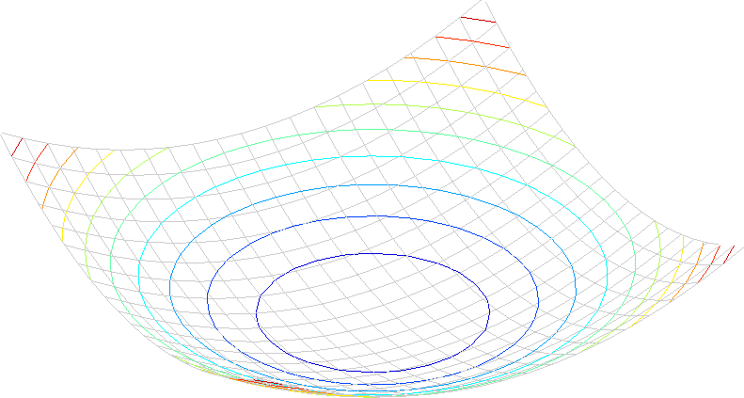
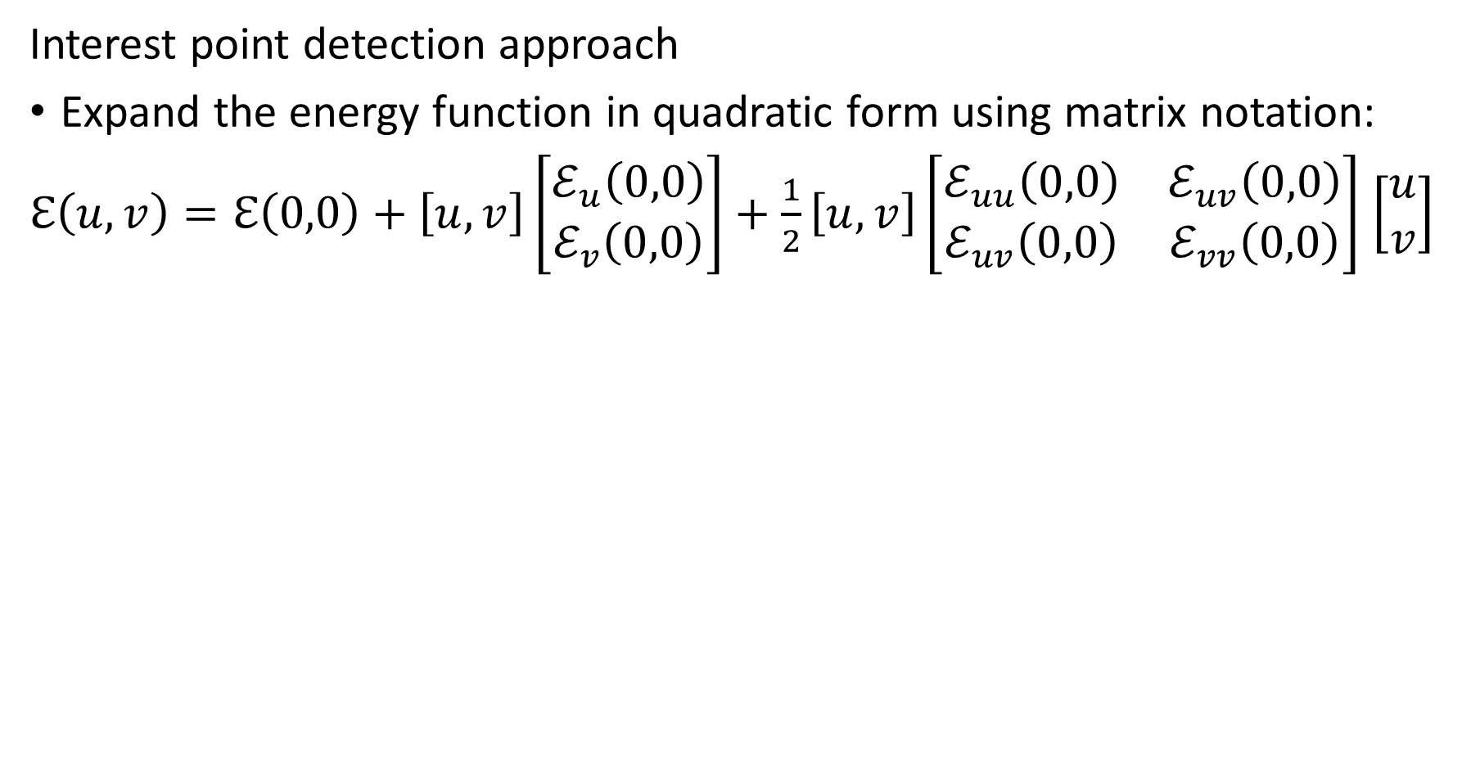

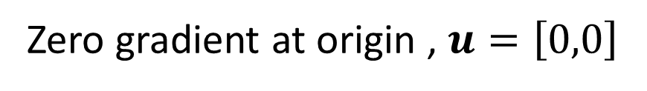
Interest Point Detection
Interest point detection approach
Expand the energy function in quadratic form using matrix notation:
$ℇ\left(u,v\right)=ℇ\left(0,0\right)+\left[u,v\right]\left[\begin{matrix}ℰ_{u}\left(0,0\right) \\ ℰ_{v}\left(0,0\right)\end{matrix}\right]+\frac{1}{2}\left[u,v\right]\left[\begin{matrix}ℰ_{uu}\left(0,0\right) & ℰ_{uv}\left(0,0\right) \\ ℰ_{uv}\left(0,0\right) & ℰ_{vv}\left(0,0\right)\end{matrix}\right]$ $\left[\begin{matrix}u \\ v\end{matrix}\right]$
Quadratic form of $ℇ\left(u,v\right)$
Zero gradient at origin , $u=\left[0,0\right]$

Slide 39
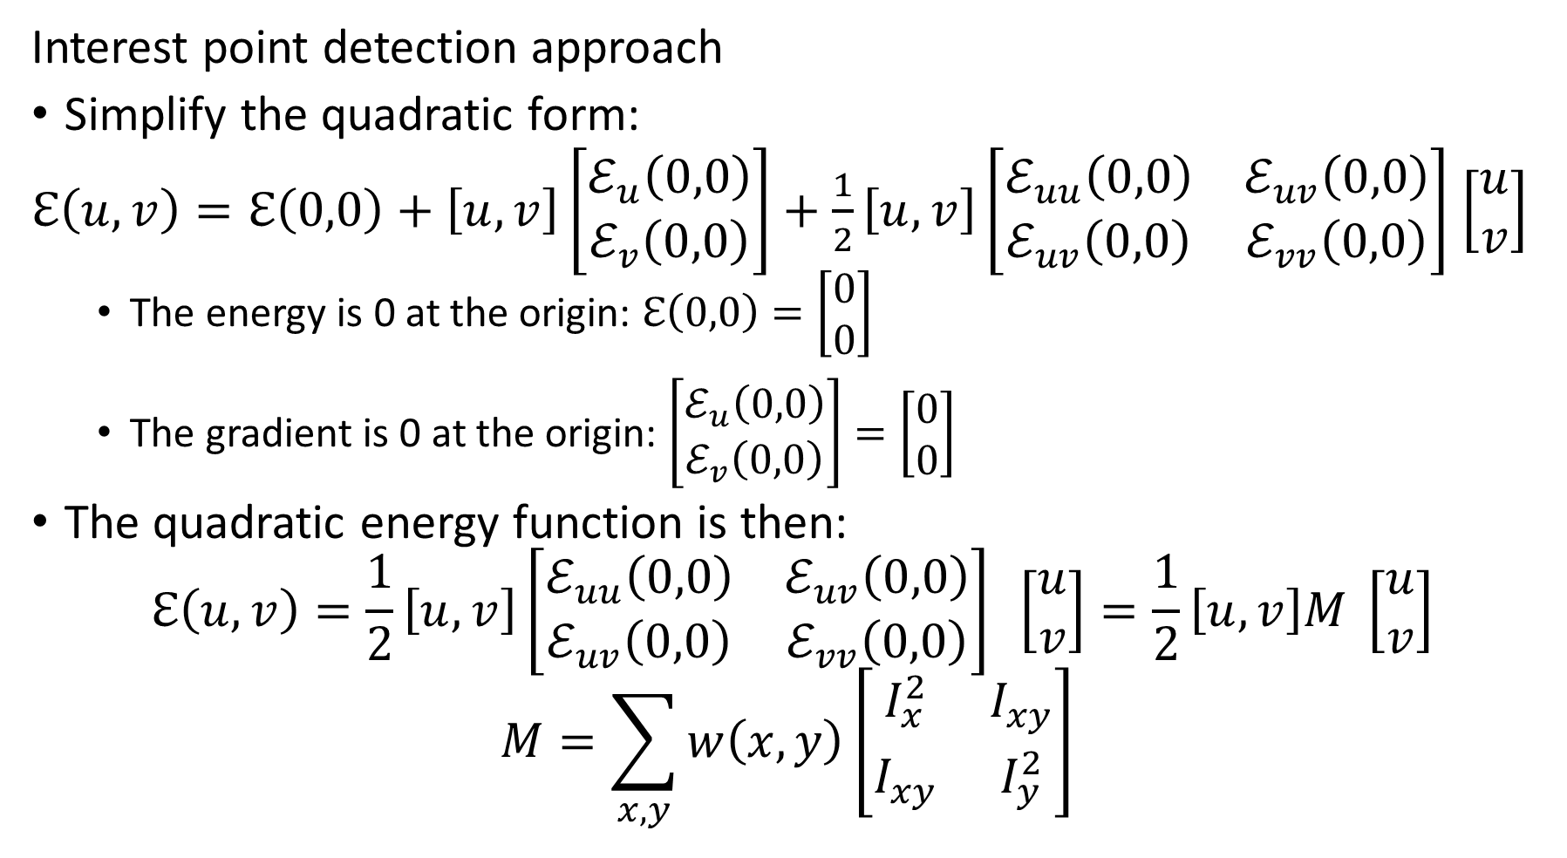
Interest Point Detection
Interest point detection approach
Simplify the quadratic form:
$ℇ\left(u,v\right)=ℇ\left(0,0\right)+\left[u,v\right]\left[\begin{matrix}ℰ_{u}\left(0,0\right) \\ ℰ_{v}\left(0,0\right)\end{matrix}\right]+\frac{1}{2}\left[u,v\right]\left[\begin{matrix}ℰ_{uu}\left(0,0\right) & ℰ_{uv}\left(0,0\right) \\ ℰ_{uv}\left(0,0\right) & ℰ_{vv}\left(0,0\right)\end{matrix}\right]$ $\left[\begin{matrix}u \\ v\end{matrix}\right]$
The energy is 0 at the origin: $ℇ\left(0,0\right)=\left[\begin{matrix}0 \\ 0\end{matrix}\right]$
The gradient is 0 at the origin: $\left[\begin{matrix}ℰ_{u}\left(0,0\right) \\ ℰ_{v}\left(0,0\right)\end{matrix}\right]=\left[\begin{matrix}0 \\ 0\end{matrix}\right]$
The quadratic energy function is then:
$$ℇ\left(u,v\right)=\frac{1}{2}\left[u,v\right]\left[\begin{matrix}ℰ_{uu}\left(0,0\right) & ℰ_{uv}\left(0,0\right) \\ ℰ_{uv}\left(0,0\right) & ℰ_{vv}\left(0,0\right)\end{matrix}\right] \left[\begin{matrix}u \\ v\end{matrix}\right]=\frac{1}{2}\left[u,v\right]M \left[\begin{matrix}u \\ v\end{matrix}\right]$$
$$M=\sum_{x,y}{w\left(x,y\right)}{\left[\begin{matrix}I_{x}^{2} & I_{xy}^{ } \\ I_{xy}^{ } & I_{y}^{2}\end{matrix}\right]}^{ }$$

Slide 40
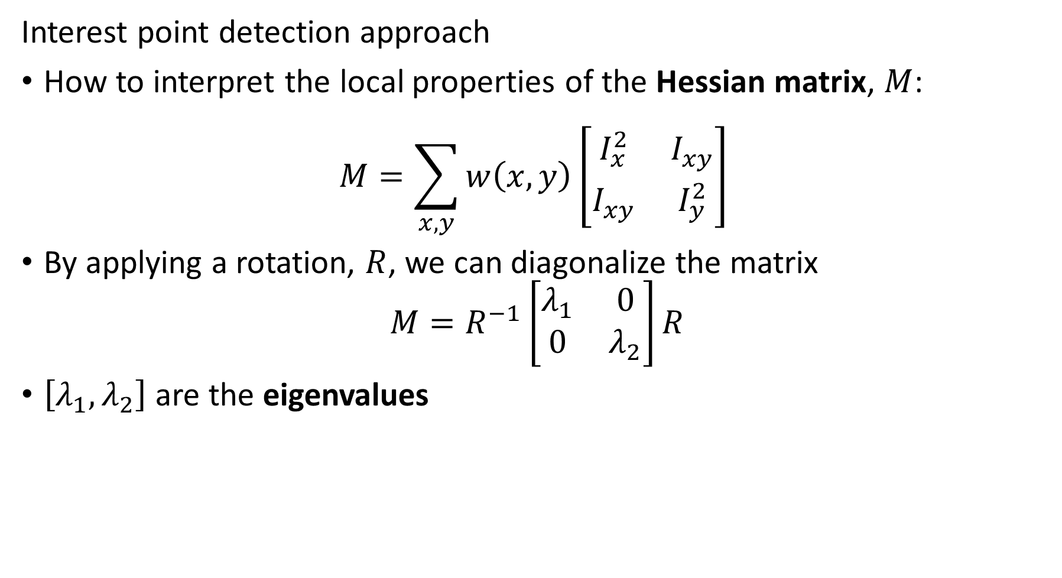
Interest Point Detection
Interest point detection approach
How to interpret the local properties of the Hessian matrix, $M$:
$$M=\sum_{x,y}{w\left(x,y\right)}{\left[\begin{matrix}I_{x}^{2} & I_{xy}^{ } \\ I_{xy}^{ } & I_{y}^{2}\end{matrix}\right]}^{ }$$
By applying a rotation, $R$, we can diagonalize the matrix
$$M=R^{−1}\left[\begin{matrix}λ_{1} & 0 \\ 0 & λ_{2}\end{matrix}\right]R$$
$\left[λ_{1},λ_{2}\right]$ are the eigenvalues

Slide 41
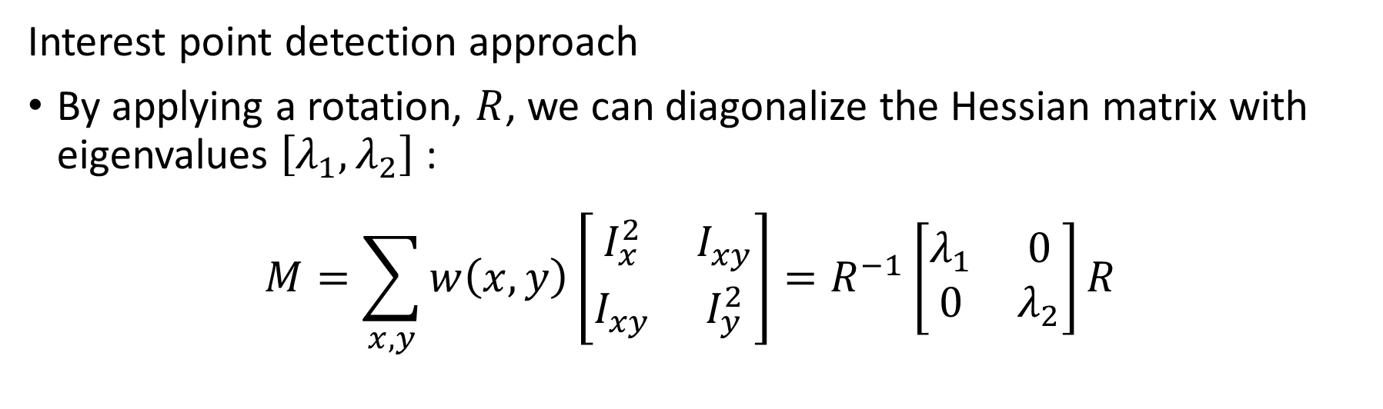
Interest Point Detection
Interest point detection approach
By applying a rotation, $R$, we can diagonalize the Hessian matrix with eigenvalues $\left[λ_{1},λ_{2}\right]$:
$$M=\sum_{x,y}{w\left(x,y\right)}{\left[\begin{matrix}I_{x}^{2} & I_{xy}^{ } \\ I_{xy}^{ } & I_{y}^{2}\end{matrix}\right]=R^{−1}\left[\begin{matrix}λ_{1} & 0 \\ 0 & λ_{2}\end{matrix}\right]R }^{ }$$
direction of the fastest change
Eigenvalues characterize the curvature
Eigenvalues parameterize curvature in the maximum and minimum directions
direction of the slowest change
(λ_{max})^{-1/2}
(λ_{min})^{-1/2}

Slide 42
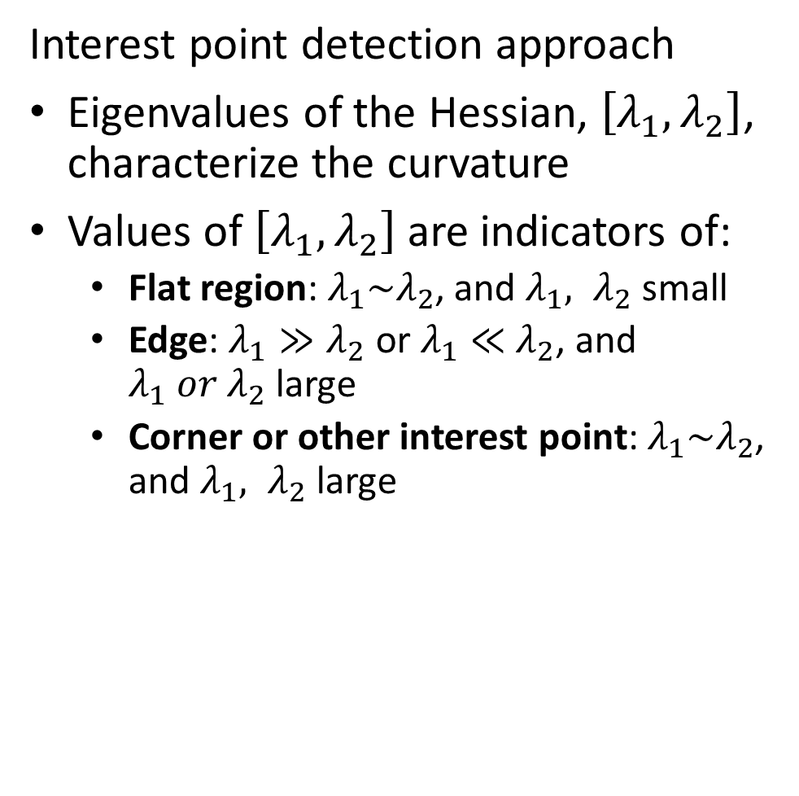
Interest Point Detection
Interest point detection approach
Eigenvalues of the Hessian, $\left[λ_{1},λ_{2}\right]$, characterize the curvature
Values of $\left[λ_{1},λ_{2}\right]$ are indicators of:
Flat region: $λ_{1}\sim λ_{2}$, and $λ_{1}, λ_{2}$ small
Edge: $λ_{1}≫λ_{2}$ or $λ_{1}≪$ $λ_{2}$, and $λ_{1} or λ_{2}$ large
Corner or other interest point: $λ_{1}\sim λ_{2}$, and $λ_{1}, λ_{2}$ large
λ₂
“Edge” λ₂ >> λ₁
“Corner” λ₁ and λ₂ are large, λ₁ ~ λ₂; E increases in all directions
λ₁ and λ₂ are small; E is almost constant in all directions
“Flat” region
“Edge” λ₁ >> λ₂
λ₁

Slide 43
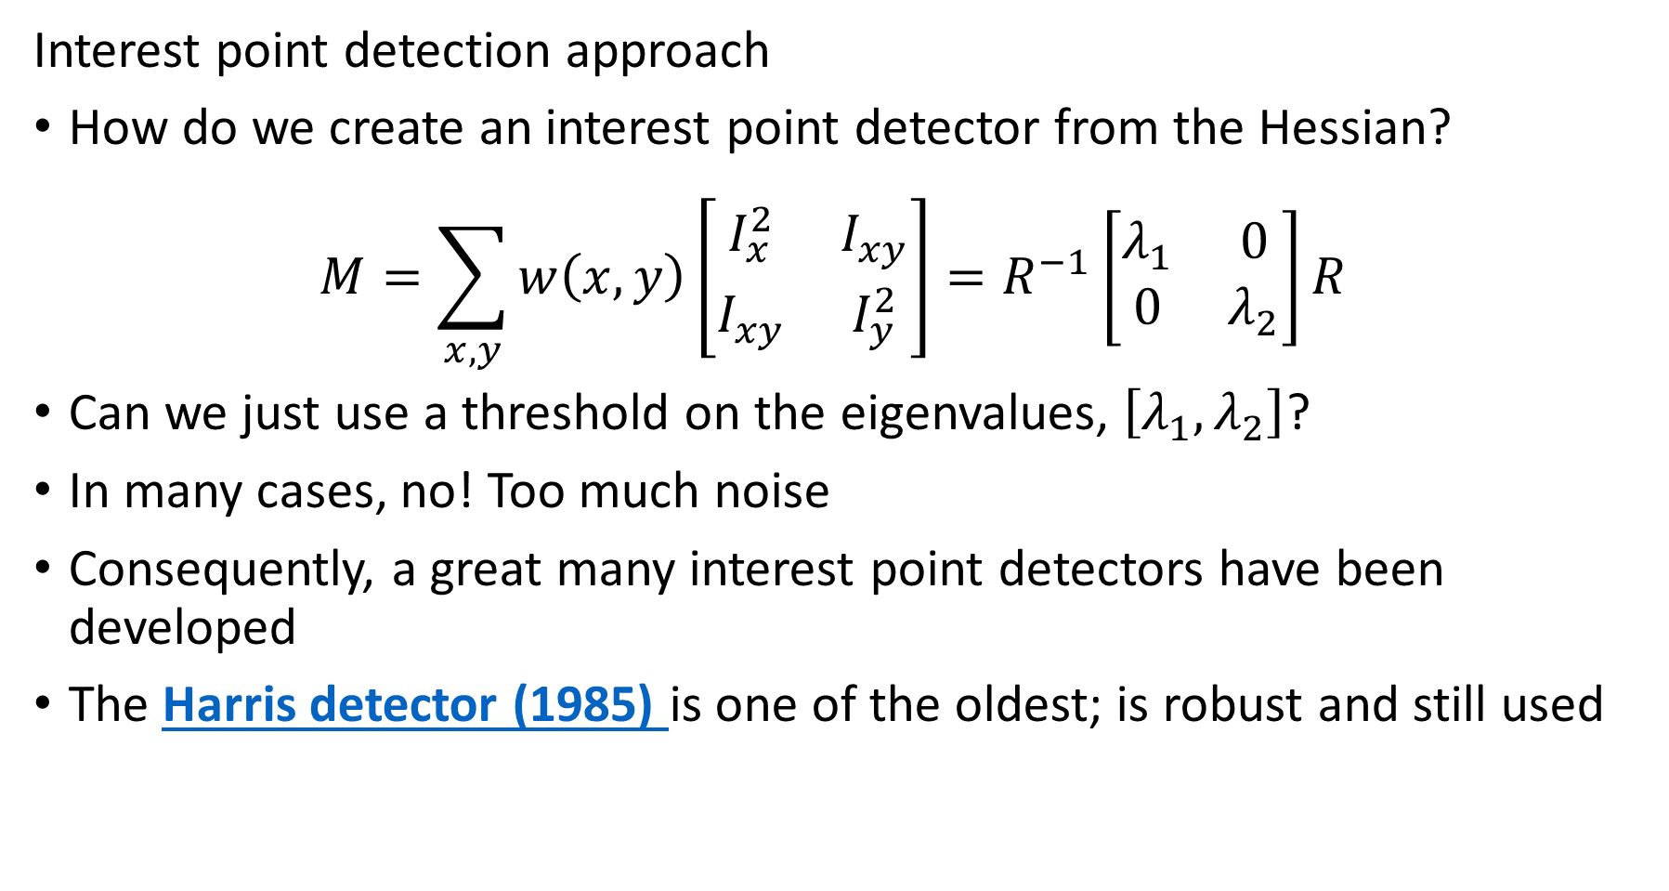
Interest Point Detection
Interest point detection approach
How do we create an interest point detector from the Hessian?
$$M=\sum_{x,y}{w\left(x,y\right)}{\left[\begin{matrix}I_{x}^{2} & I_{xy}^{ } \\ I_{xy}^{ } & I_{y}^{2}\end{matrix}\right]=R^{−1}\left[\begin{matrix}λ_{1} & 0 \\ 0 & λ_{2}\end{matrix}\right]R }^{ }$$
Can we just use a threshold on the eigenvalues, $\left[λ_{1},λ_{2}\right]$?
In many cases, no! Too much noise
Consequently, a great many interest point detectors have been developed
The Harris detector (1985) is one of the oldest; is robust and still used

Slide 44
Harris Algorithm

Slide 45
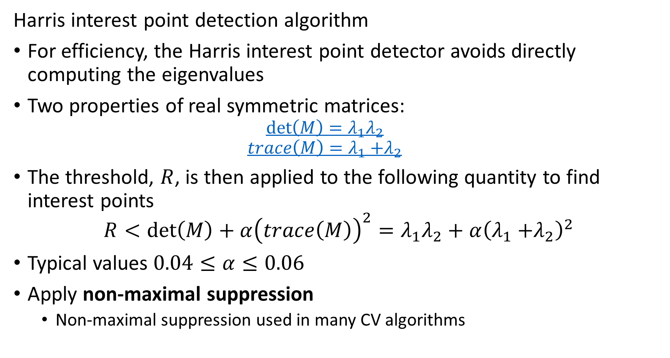
Harris Interest Point Detection
Harris interest point detection algorithm
For efficiency, the Harris interest point detector avoids directly computing the eigenvalues
Two properties of real symmetric matrices:
$$\det\left(M\right)=λ_{1}λ_{2}$$
$$trace\left(M\right)=λ_{1}{+λ}_{2}$$
The threshold, $R$, is then applied to the following quantity to find interest points
$$R<\det\left(M\right)+α{\left(trace\left(M\right)\right)}^{2}=λ_{1}λ_{2}+α{\left(λ_{1}{+λ}_{2}\right)}^{2}$$
Typical values $0.04≤α≤0.06$
Apply non-maximal suppression
Non-maximal suppression used in many CV algorithms

Slide 46
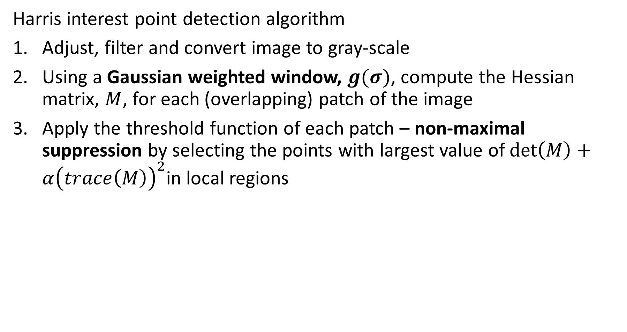
Harris Interest Point Detection
Harris interest point detection algorithm
Adjust, filter and convert image to gray-scale
Using a Gaussian weighted window, $g(σ)$, compute the Hessian matrix, $M$, for each (overlapping) patch of the image
Apply the threshold function of each patch – non-maximal suppression by selecting the points with largest value of $\det\left(M\right)+α{\left(trace\left(M\right)\right)}^{2}$in local regions

Slide 47

Harris Interest Point Detection
Steps of Harris interest point detection algorithm
Adjust, filter and convert image to gray-scale
Image from slide by S. Lazebnik

Slide 48

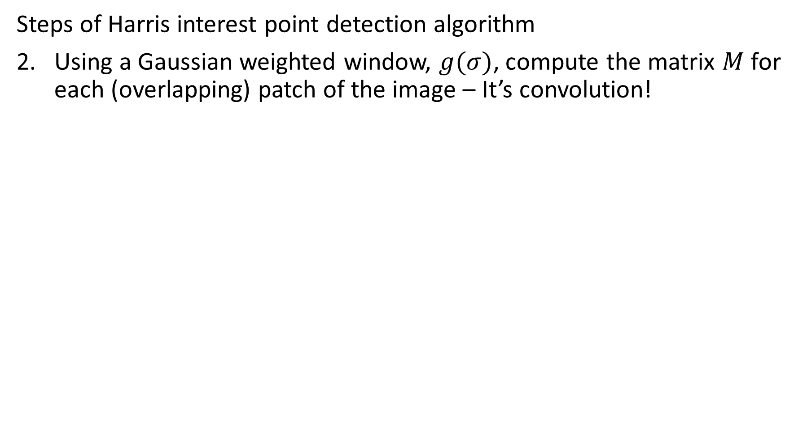
Harris Interest Point Detection
Steps of Harris interest point detection algorithm
Using a Gaussian weighted window, $g(σ)$, compute the matrix $M$ for each (overlapping) patch of the image – It’s convolution!
Image from slide by S. Lazebnik

Slide 49

Harris Interest Point Detection
Steps of Harris interest point detection algorithm
Apply the threshold function of each patch
Image from slide by S. Lazebnik

Slide 50
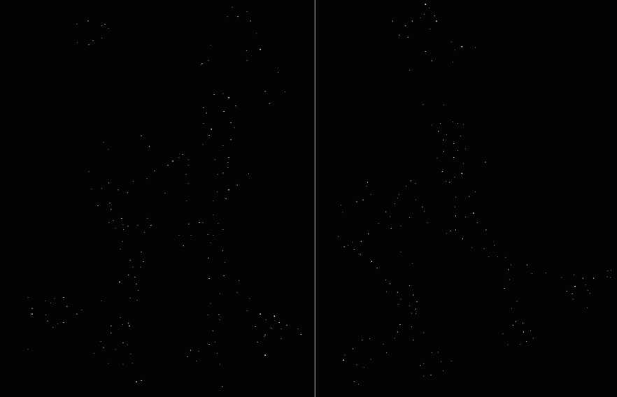
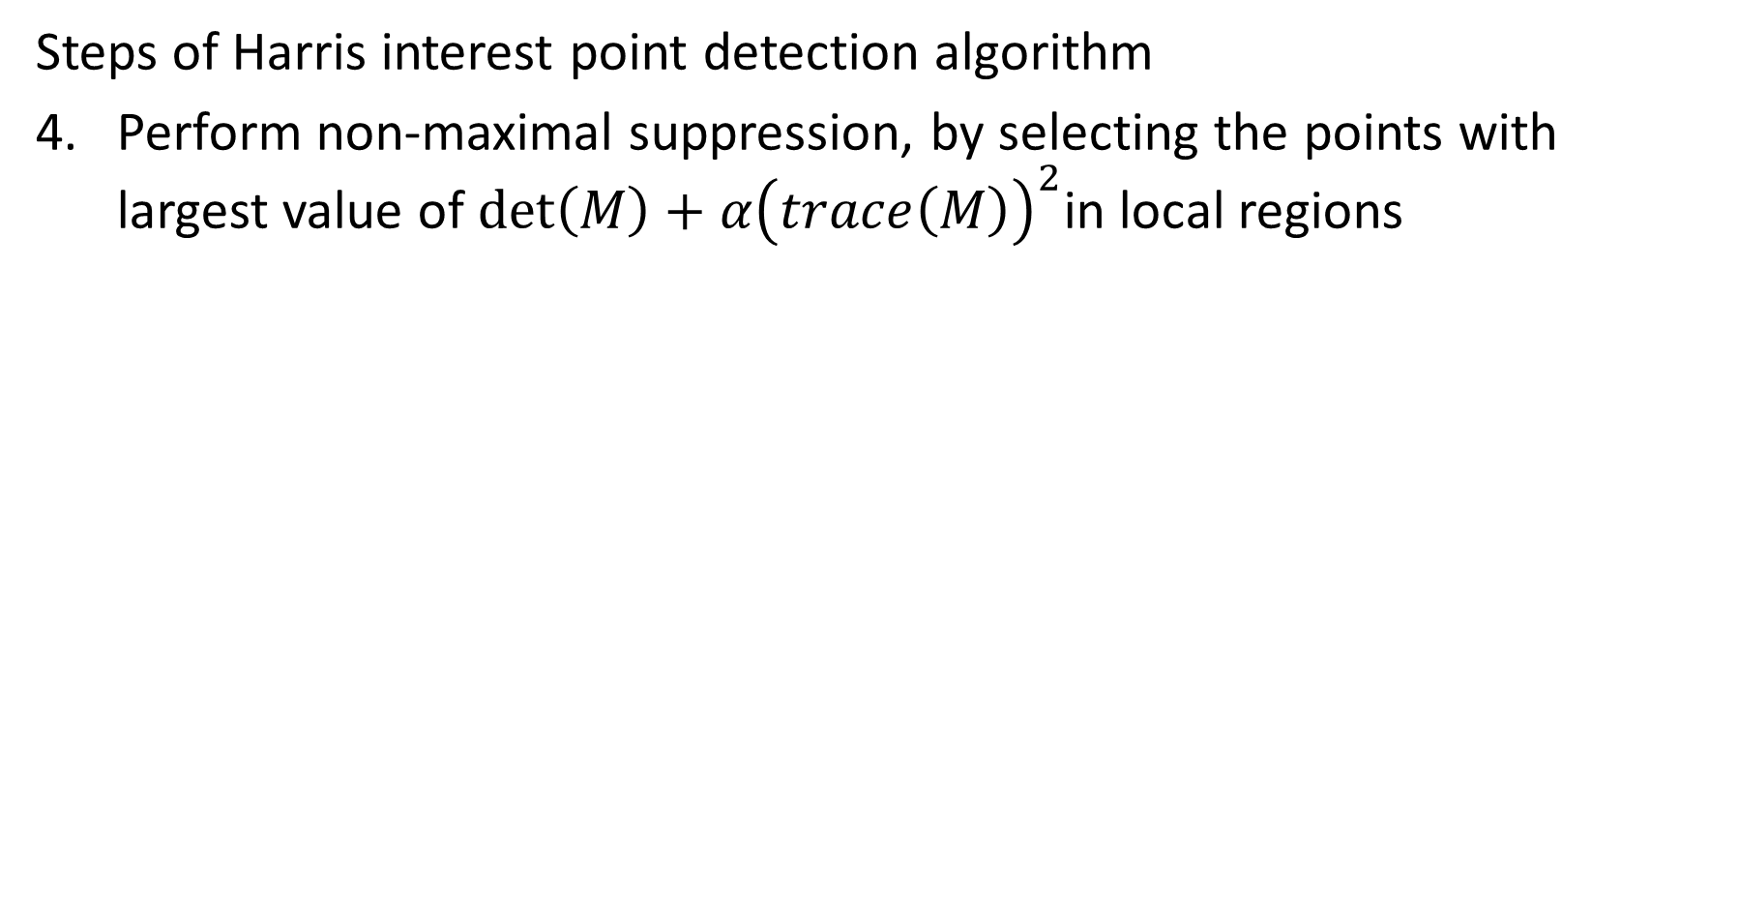
Harris Interest Point Detection
Steps of Harris interest point detection algorithm
Perform non-maximal suppression, by selecting the points with largest value of $\det\left(M\right)+α{\left(trace\left(M\right)\right)}^{2}$in local regions
Image from slide by S. Lazebnik

Slide 51
Harris Interest Point Detection
Why is the Harris algorithm shift and rotationally invariant
Shift invariant: The convolutional Laplacian gradient kernel is applied across the image
Response of convolution only depend on local gradient, not location
Rotationally invariant: The eigenvalues are rotationally invariant
Eigenvectors project the gradient values to the principal axes
Eigenvalues remain unchanged
Not scale invariant: The response of the Laplacian operator changes with local gradient and scale of the operator, σ
Use image pyramid to deal with different scales
Regardless of algorithm, we need feature maps to be have these invariance properties!

Slide 52
Gradients and Features – the HOG Algorithm

Slide 53
Gradients and Features
Gradients are powerful features
Patterns of direction of maximum gradient can help identify objects in the image
But gradients are extremely noisy
Idea; average histogram of gradients over patches on the image
Basis of the Histogram of Oriented Gradients (HOG) algorithm, Dalal and Triggs (2005)
HOGs generate powerful features
Particularly good for objects with long linear features
Computationally intensive
Typically apply HOG to each color channel or convert to gray-scale

Slide 54
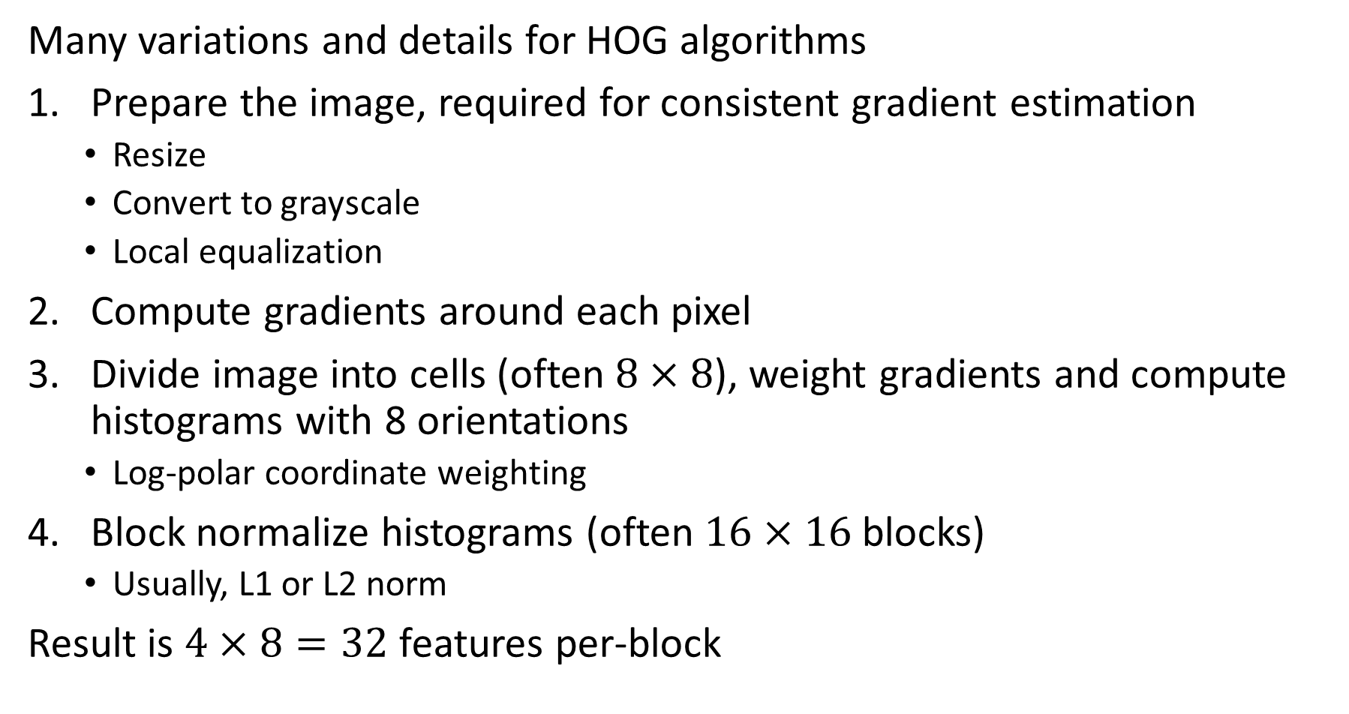
Gradients and Features
Many variations and details for HOG algorithms
Prepare the image, required for consistent gradient estimation
Resize
Convert to grayscale
Local equalization
Compute gradients around each pixel
Divide image into cells (often $8×8$), weight gradients and compute histograms with 8 orientations
Log-polar coordinate weighting
Block normalize histograms (often $16×16$ blocks)
Usually, L1 or L2 norm
Result is $4×8=32$ features per-block

Slide 55
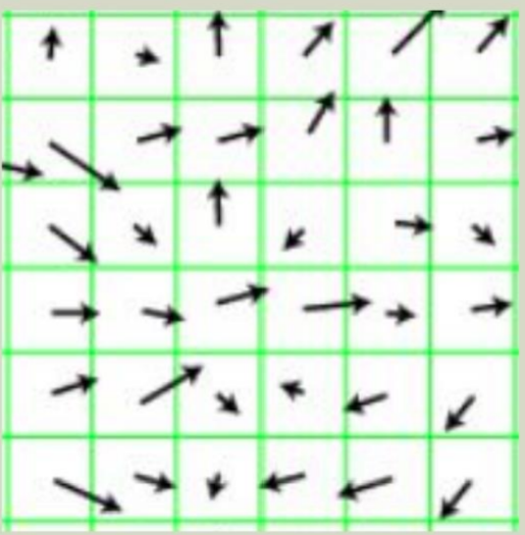
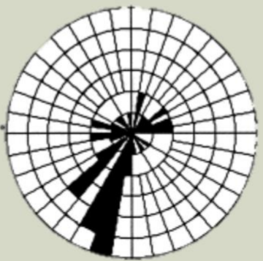
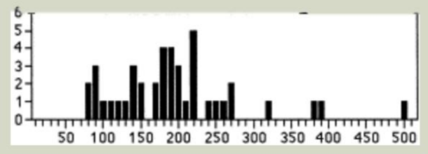
Gradients and Features
Basic steps of HOG algorithms
Gradients of image patch
Histogram in log-polar coordinates
Normalized feature vector
Adapted Stanford CS-131 slides Neibles and Wu

Slide 56
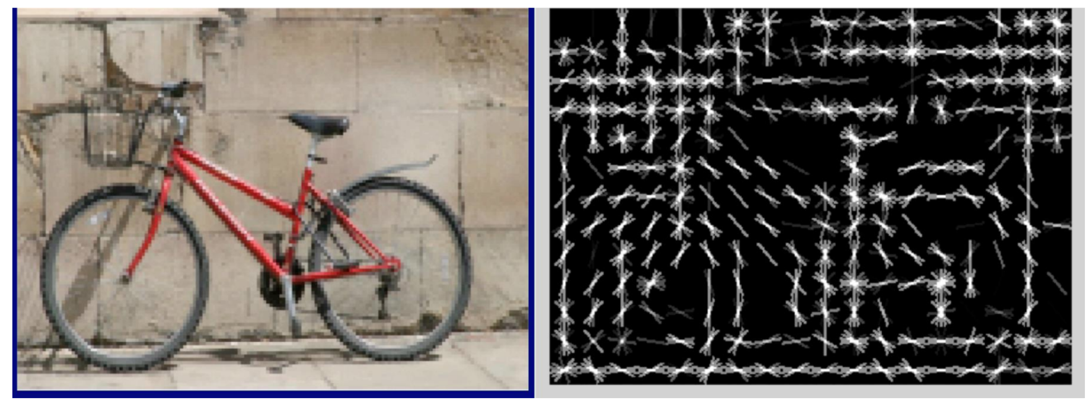
Gradients and Features
Example of HOG – features to identify a bicycle
Adapted Stanford CS-131 slides Neibles and Wu

Slide 57
Interest Point Descriptors

Slide 58


Interest Point Descriptors
Must identify interest points between complex images
Matching interest points can be difficult
Image from Oxford Dataset, Mikolajczyk, et. al., 2005

Slide 59
Interest Point Descriptors
Must identify interest points between complex images
Can we just use the set of interest points?
Not directly, can’t tell the features apart
Need to use properties of the regions - descriptors
Some ideas
Intensity
Color ratios
texture
Local gradient statistics ✔

Slide 60


Interest Point Descriptors
Must identify interest points between complex images
Harris detector is not scale independent – not suitable
Change Scale
Harris detector identifies this feature as a corner
But, Harris detector identifies this feature as a series of edges

Slide 61

Interest Point Descriptors
Must identify interest points between complex images
How well can intensity or color ratios identify features
Create intensity histograms for region (patch) around feature
Small shifts and rotations can change intensity and histogram
Need a more invariant solution!
Figure by Andrew Zisserman

Slide 62
Interest Point Descriptors
Must uniquely identify interest points between complex images
Need a more invariant solution!
Scale invariant
Shift invariant
Rotationally invariant

Slide 63
Interest Point Descriptors
Key properties of good descriptors
Locality: features describe parts and are robust to occlusion and clutter
Distinctiveness: identifiable from a large set of interest points
Quantity: generated multiple distinctive features, even for small objects
Efficiency: close to real-time performance
Extensibility: can easily be extended to wide range of different feature types, each adding robustness to changes

Slide 64
Interest Point Descriptors
Must identify interest points between complex images
Many shift and rotationally invariant algorithms have been developed:
SHIFT
SURF
DAISY
BRIEF
CENTURE
…
Use hierarchy of scales with interest point descriptors, a feature pyramid

Slide 65
SHIFT Algorithm

Slide 66

The SIFT Algorithm
Scale Invariant Feature Transformation (SIFT)
SIFT developed by David Lowe (1999 and 2004)
Algorithm
Divide image into $16×16$ patches
Divide a $16×16$ array of pixels into 16 $4×4$ cells
Compute the gradients at each pixel
Create an 8-direction histogram of gradient direction for each cell, gives $16×8=128$ features
Normalize the descriptor so that:
$$<0.2 and \sum_{i}{d_{i}^{2}=1.0}$$

Slide 67





The SIFT Algorithm
Scale Invariant Feature Transformation (SIFT)
Gradients computed for $16×16$ pixel array
8-direction histograms for each $4×4$ cell
Descriptor is normalized histogram values
Adapted from slide by David Lowe

Slide 68

The SIFT Algorithm
How can SIFT be made rotationally invariant?
Start with the gradients on the $16×16$ grid
Find the mean gradient direction
Histogram directions are computed relative to the mean direction
General approach to rotational invariance used with other descriptors
Adapted from slide by David Lowe

Slide 69
The BRIEF Algorithm

Slide 70

The BRIEF Algorithm
The BRIEF feature descriptor is an efficient and robust feature descriptor
- Steps of the BRIEF algorithm:
For each interest point in each image define a sample patch
Random sample two pixels from the patch
Compute the binary statistic, in the set $\left[0,1\right]$, $τ\left(p;x,y\right)$
Add the statistic to the mini-hash
Repeat steps 2-4 until $n_{d}$ bits of the mini-hash accumulated
For each possible pair of patches in two images compute the Hamming distance
Match interest points with highest similarity, small Hamming distance

Slide 71

The BRIEF Algorithm
How is the binary mini-hash string computed?
BRIEF computes the binary values of the mini-hash by the following relationship:
$$τ\left(p;x,y\right)=\left\{\begin{aligned}1 if p(x)<p(y) \\ 0 otherwise\end{aligned}\right.$$
The n binary values are organized into the $n_{d}$ dimensional binary mini-hash:
$$f_{n_{d}}=\sum_{1≤i≤n_{d}}{2^{i−1}}τ\left(p;x,y\right)$$
Differences between descriptors is the Hamming distance

Slide 72


The BRIEF Algorithm
How are the pixels sampled?
Pairs of pixel locations, $\left[x,y\right]$, in the patch are randomly sampled
The binary statistic, $τ\left(p;x,y\right)$, is computed given the randomly sampled pixel values, $p\left(x\right), p(y)$
The binary value is added to the mini-hash vector
Calonder, et.al. found Gaussian sampling is generally best

Slide 73

The BRIEF Algorithm
How can you find the Hamming distance?
For binary strings, Hamming distance is the XOR between the strings
$$h\left(f_{n_{1}},f_{n_{2}}\right)=f_{n_{1}}⨁f_{n_{2}}$$
XOR is often supported by CPU - very fast and massively scalable!
Example: Let $f_{n_{1}}=[1,0,1,1,0,0,1]$ and $f_{n_{1}}=[1,1,1,1,0,0,0]$, the Hamming distance is:
$$h\left(f_{n_{1}},f_{n_{2}}\right)=\left\{\begin{aligned}[1,0,1,1,0,0,1] \\ ⨁ \\ [1,1,1,1,0,0,0]\end{aligned}=2\right.$$

Slide 74

The BRIEF Algorithm
Example of difficult interest point problem
Wall image from Calonder, et.al.
This is a hard problem!
Corners look similar

Slide 75


The BRIEF Algorithm
How well does the BRIEF Algorithm work?
Calonder, et.al. show that there is diminishing improvement beyond a 256 bit (256 test) mini-hash
Computation of only 256 binary statistics, $τ\left(p;x,y\right)$, is fast per patch
The limit of correct recognition depends on the nature of the images
Wider angles between images reduce recognition with all descriptors

Slide 76
Multi-Scale Interest Points

Slide 77

Multi-Scale Feature Identification
Pyramid structure enables extraction of interest points at several scales
Pyramid scales from fine to coarse in octaves
Features at each scale extracted
Can use a variety of interest point descriptor algorithms
SIFT
Harris – Laplacian
Neural networks
x
Diagram by Saad Bedros

Slide 78



Multi-Scale Feature Identification
Scaling using Laplacian or DoG
Scaling applies convolution with kernel, $K$, on image $I$: $I_{scaled}=K∗I$
Laplacian
$$ℒ=σ^{2}\left[G_{xx}\left(x,y,σ\right)+G_{yy}\left(x,y,σ\right)\right]$$
DoG
$$DoG=G_{ }\left(x,y,σ\right)−G_{ }\left(x,y,kσ\right)$$
Where Gaussian is:
$$G_{ }\left(x,y,σ\right)=\frac{1}{2πσ}exp\left(−\frac{x^{2}+y^{2}}{2σ^{2}}\right)$$
Both kernels are rotationally invariant

Slide 79


Multi-Scale Feature Identification
Scaling DoG
Scaling applies convolution with kernel, $K$, on image $I$: $I_{scaled}=K∗I$
Example: pyramid with DoG, $G_{ }\left(x,y,σ\right),G_{ }\left(x,y,kσ\right),G_{ }\left(x,y,k^{2}σ\right), …$
Diagram by Krystian Mikolajczyk

Slide 80


Multi-Scale Feature Identification
Scaling DoG
Scaling applies convolution with kernel using ${k σ}^{ }, k=1,2,..,5$
Determine scale with maximum of descriptor
Adapted from diagram by Krystian Mikolajczyk

Slide 81
Summary
Key points for this lesson
Good feature maps are required to perform CV tasks
Use of gradients to detect edges
Edge enhancement with Hough transform
Interest point detectors
Edges are ambiguous detectors
Laplacian and DoG detect interest points
Need Hessian to have two large eigenvalues
Use non-maximal suppression to filter interest points
Ideal feature detectors should be invariant to
Shift
Rotation
Scale

Slide 82
Summary
Key points for this lesson
Ideal feature detectors should have these properties
Locality
Distinctiveness
Quantity
Efficiency
Extensibility
Use feature descriptor to differentiate features
Similar descriptors match features between images
Use scale pyramid to make feature detectors scale invariant.

